Slide 1
Division of State Associations of Chiefs of Police
Chief Cliff Block, General Chair, SACOP

Slide 2

SACOP 101:

Slide 3
Regions
North Atlantic
  Chief Richard McCabe, New Castle Police Department, Delaware | Regional Chair
  Undersheriff Mark Spitzer, Morris County Sheriff’s Office, New Jersey I Vice Chair
North Central
  Chief Jeremy Logan, Oelwein, Iowa I Regional Chair
  Chief Eric Werner, Maple Grove, Minnesota I Vice Chair
Mountain Pacific
  Chief Rick Scott, San Luis Obispo, California I Regional Chair
  Chief Travis Koltiska, Sheridan, Wyoming I Vice Regional Chair
Southern
  Chief Todd Hunter, Kilgore, Texas I Regional Chair
  Chief Robert Bage, Fort Walton Beach, Florida I Vice Chair

Slide 4
Purpose: “Rule 17”
The Division of State Associations of Chiefs of Police (SACOP) serves as the organizing body for the individual state associations of chiefs of police. SACOP also functions as the coordinating body between the state associations and the IACP, facilitating the exchange and dissemination of information related to a host of important topics in law enforcement. SACOP works to: create policy guidance on timely and relevant topics in law enforcement; facilitate and encourage dialogue between local law enforcement, state, and federal partners; provide tools and resources for members to more effectively manage their individual association; and provide training programs and presentations on a wide array of subjects.

Slide 5
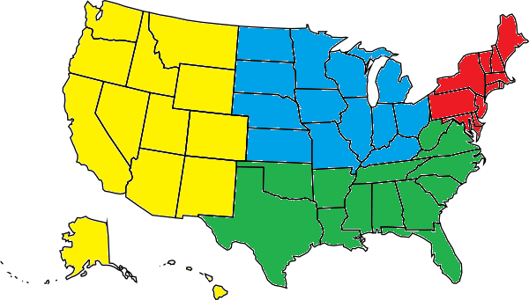
Mountain Pacific
North Central
North Atlantic
South

Slide 6
SACOP Members
State Association President
State Association Executive Director
SACOP Representative from each state
Each state has one vote
Annual dues are $500 per state

Slide 7
Member Responsibility
Act as a liaison between State Association and IACP through SACOP
Represent state issues to IACP and IACP issues to State
  Foster good communication
Attend Midyear, Annual Conference, and regional meetings/calls

Slide 8
IACP Staff
Gene Voegtlin
  Director, Policy & Governance
David Snively
  Assistant Director, Policy & Governance
Member Engagement
  Andrea Watson, Program Manager
  Jill Henry, Project Coordinator

Slide 9
Staff Responsibilities
Coordinate SACOP initiatives
  With other divisions, committees, and sections
Research funding/partnerships
Provide meeting and operational support
Identify emerging issues and coordinate/advocate for SACOP
SACOP Update (weekly newsletter)

Slide 10
Executive Committee
General Chair I Chief Cliff Block, University Center, MI 2025
  Member of the IACP Executive Board
Vice-General Chair I Chief Tom Wickman, Frisco, CO 2027
  Member of the IACP Board of Directors (ex-officio) and member of the Resolutions Committee
Regional Chairs, in ascending order to General Chair
  North Atlantic I Chief Richard McCabe, New Castle, DE 2029
  Southern I Chief Todd Hunter, Kilgore, TX 2031
  North Central I Chief Jeremy Logan, Oelwein, IA 2033
  Mtn Pacific I Chief Rick Scott, San Luis Obispo, CA 2035

Slide 11
Executive Committee
At-Large Member I Eric Werner, Maple Grove, MN
Executive Director Committee Chair I Pat Phelan, New York State Association of Chiefs of Police)
Non-voting Members
  Vice Regional Chairs, must still be heads of their agencies while in this role.
  SACOP Parliamentarian I Chief (Ret.) and Executive Director James McLaughlin
  Immediate Past General Chair I Chief Jim Williams, Staunton, VA
  Past General Chair I Chief Jim Hicks, Natick, MA

Slide 12
Terms of Office
General Chair – Two years; then “Immediate Past General Chair”
Vice-General Chair – Two years; ascends to General Chair
Region Chairs – Until ascending to Vice General Chair
  North Atlantic, Southern, North Central, and Mountain Pacific
Immediate Past General Chair - Two years
At Large, Committee/Section Chairs, Sgt.-at-Arms , and Parliamentarian are appointed by the Division Chair

Slide 13
Committees/Sections
Executive Directors
  Open to State Association Executive Directors

Slide 14
Representation
Policy Council Advisory Group PCAG (Chief Jim Williams, Immediate Past Chair)
IACP Resolutions Committee (Chief Tom Wickman, SACOP Vice Chair)
Co-Chair Officer and Safety Wellness Policy Council (Chief Cliff Block General Chair)

Slide 15
Goals/Objectives
Recruiting
  States who do not participate
    Missed opportunity for State Associations and SACOP
    Chiefs who are State Association members but not IACP members
Organization
  Update and better define role of Division, SACOP Representatives, Executive Committee, and Association Presidents and Executive Directors

Slide 16
Goals/Objectives
Collaborate
  State & Provincial Police Division
  Mid-Sized Agencies Division
Focus areas
  Community-Police Relations / Trust
  Police Culture
  Information sharing
  Officer Safety and Wellness

Slide 17
SACOP Meetings
Annual Meeting
  Held at Annual Conference
  Committee/Section/Regional Meetings
  Business Meeting
2027 Mid-Year Meeting
  February 24 -26, Long Beach, CA
  Joint Meeting with S&P and Mid-Sized Agencies Divisions

Slide 18
Questions?
Chief Cliff Block
Saginaw Valley State University Police Department, Michigan
cablock@SVSU.edu

