Slide 1



Suicide

Slide 2

Module Overview
Overview of Suicide
Risk Factors and Warning Signs
Tips for Response

Slide 3
Suicide Overview
There is approximately one death by suicide every 11 minutes in the United States
Older adults (ages 75 and older) have the highest suicide rate
Men die by suicide about 4x more often than women
Non-Hispanic American Indian/Alaska Natives have the highest suicide rate, followed by non-Hispanic White populations
Firearms are used in over 50% of suicides; suffocation is the second most common method

Slide 4
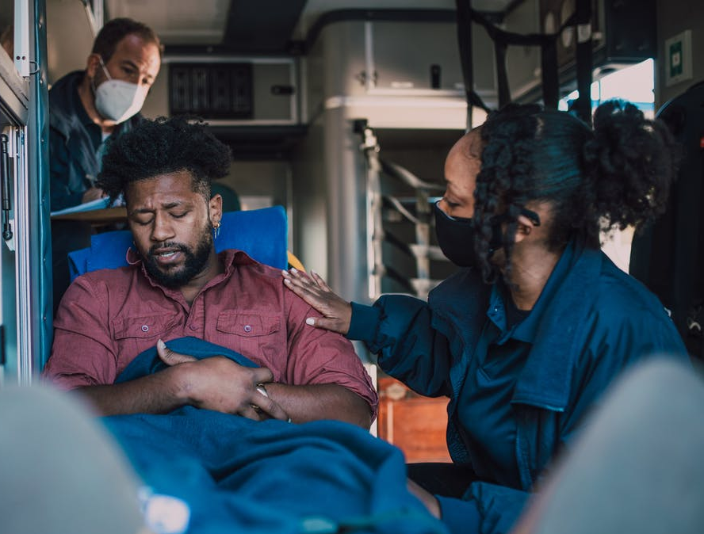
The Criminal Justice Response
Police officers are routinely dispatched to potential suicides
For first responders, potential suicides can be a very dangerous type of intervention
Q&A

Slide 5

Suicide: Definitions
Suicidal Thoughts
Suicide Attempt
Died by Suicide

Slide 6
Suicide Risk Factors
Historical
Health
Prior suicide attempts
Family history of suicide
History of trauma or abuse
Mental health condition
Serious or chronic health condition and/or pain
Substance use
Environmental
Access to lethal means
Stressful life events
Prolonged stress
Few existing resources
Exposure to another person’s suicide, including in the media.

Slide 7
Suicide Warning Signs
Mood
Behavior
Depression
Anxiety
Irritability
Loss of interest
Relief
Agitation
Developing plan for suicide
Withdrawing from activities
Looking for a way to kill themselves
Developing plans for final arrangements
Isolating from family and friends
Talk
Being a burden to others
Feeling trapped, being in unbearable pain
Talk of killing themselves, wanting to die
Having no reason to live
Feeling hopeless
Constant suicidal thoughts

Slide 8
How Do You Ask About Suicide?
Two steps:
Briefly describe the warning signs you are concerned about
  “Your mom tells me you haven’t wanted to go out at all…”
  “You’ve had a lot of losses, and you sound very depressed…”
Ask directly about suicide
  “Others in similar circumstances have thought of ending their life. Have you thought of killing yourself?”
Q&A

Slide 9
How Do You Ask About Suicide?
Questions to Ask
“YES” Follow-up Questions to Ask
Are you thinking about hurting or killing yourself?
When would you do it?
(today, tomorrow, next week)
Have you ever wished you were dead or that you could go to sleep and not wake up?
How often do you feel that way?
Do you ever feel so badly that you think about suicide?
How would you do it?
Do you have a plan to die by suicide or take your life?
Does it have to be today?

Slide 10
Assessing Suicide
S.A.L. METHOD
Specific – How specific are the details of the plan?
Available – Is the instrument (weapon, pills, etc.) available to carry out the plan?
Lethal – How lethal is the proposed method?

Slide 11


Three Key Words to Be Aware of
HOPELESS
HELPLESS
WORTHLESS

Slide 12


Video: The Bridge Between Suicide and Life
Q&A
Notes:
https://www.youtube.com/watch?v=7CIq4mtiamY&ab_channel=TED (14:13)

Slide 13

Dangerousness to Others
Ask if the person has any thoughts about hurting or killing other people.
If yes:
Does the person intend to act on them?
Who is the intended victim?
What is the plan?
Does the person have access to the means to carry out the plan?
What have they done in the past?

Slide 14
Be Aware of Officer-Assisted Suicide
Officer-assisted suicide (“suicide-by-cop”) is a method of suicide in which a person experiencing suicidal thoughts deliberately acts in a threatening manner with the goal to provoke a lethal response from police.
Two Types:
Planned
Crisis-Driven
Q&A

Slide 15

Officer-Assisted Suicide (continued)
Verbal & Behavioral Cues
Approach
  Maintain distance; safety first
  Slow down pace (when possible)
  Calm, slow voice
Establish Dialogue
  What can I do to help you?
  What happened?
  Explore resolutions

Slide 16

Keep These Things in Mind:
Most suicide attempts are expressions of extreme distress or psychological pain, not harmless bids for attention. Most people don’t want to end their lives; they want to end their pain.
A person who appears to be contemplating suicide should not be left alone.
A person who appears to be contemplating suicide needs immediate mental health treatment.
Suicide is almost always preventable.

Slide 17
Tips for Responding
Listen
Don’t minimize the person’s feelings
Tell the person you want to help
QUICK TIPS

Slide 18
Tips for Responding (continued)
Avoid statements such as…
  “It’ll get better”
  “I know how you feel”
Ask directly about suicide
Offer hope
QUICK TIPS

Slide 19

Hope, Help, and Worth
HOPE
HELP
WORTH

Slide 20


Module Wrap-Up
Questions?
This curriculum was created through support by Grant No. 2020-NT-BX-K001 awarded by the Bureau of Justice Assistance. The Bureau of Justice Assistance is a component of the Department of Justice’s Office of Justice Programs, which also includes the Bureau of Justice Statistics, the National Institute of Justice, the Office of Juvenile Justice and Delinquency Prevention, the Office for Victims of Crime, and the SMART Office. Points of view or opinions in this document are those of the authors and do not necessarily reflect the official positions or policies of the U.S. Department of Justice.

