Slide 1



Intellectual and Developmental Disabilities

Slide 2

Module Overview
Developmental Disabilities
Common Interactions
Response Tips for Officers
  Identification
  Communication

Slide 3
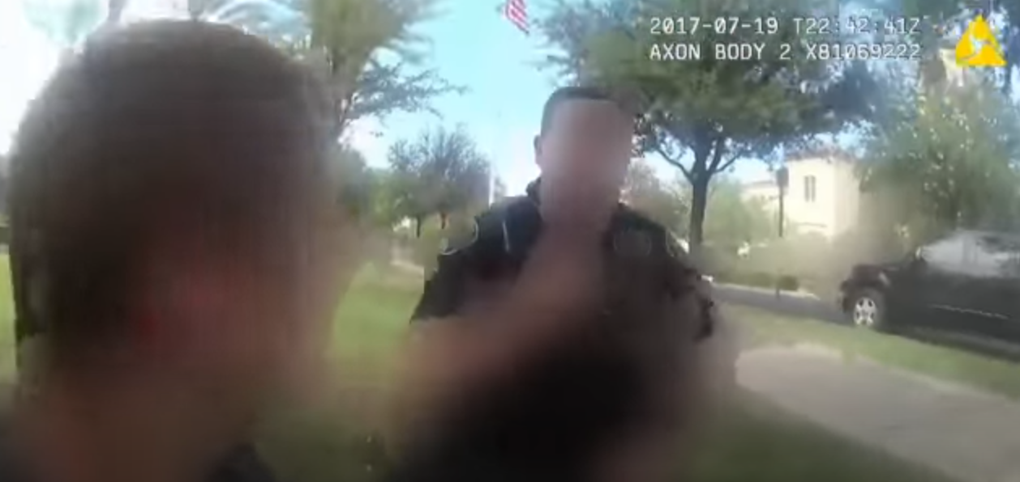

VIDEO:
Officer Interaction with a Teen with Autisma
Q&A
Play the video to 5:40
Notes:
Video Activity: Body Camera Footage of Officer Interaction with Teen with Autism
https://www.youtube.com/watch?v=FL5_ePqmH2Q&t=8s&ab_channel=12News (Play up to 5:40)

Slide 4
Categories of Disabilities
Sensory
Developmental
Physical
Learning
Age-Related
Mental Health

Slide 5
Developmental Disabilities
Physical and/or mental impairments that begin before age 22 and are likely to continue indefinitely
Substantial functional limitations in at least three of these:
    Self-care
    Learning
    Walking/moving around
    Self-direction
    Independent living
    Economic self-sufficiency
    Language

Slide 6
Developmental Disabilities and
Mental Health Conditions
Developmental Disabilities
Onset before age 22
Life-long symptoms
May affect cognition, learning, language, or physical movement
Medications cannot fully restore or alleviate symptoms
Mental Health Conditions
Onset at any age
Symptoms may be episodic or temporary
May affect perceptions, emotions, or thought processes
Medications can help control or alleviate symptoms
1/3

Slide 7
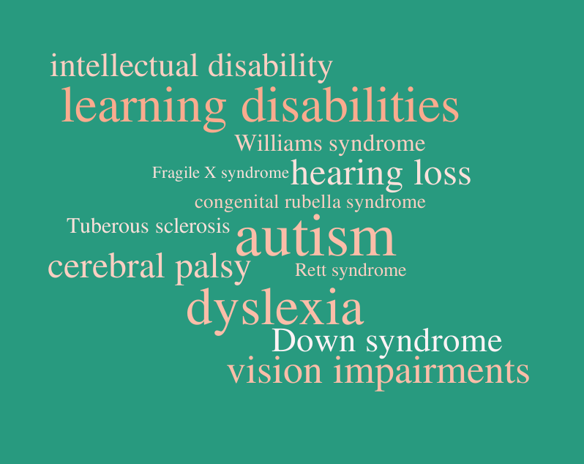
Disability Word Cloud
Q&A

Slide 8
Intellectual Disability
Limitations:
  Intellectual functioning
  Adaptive behavior (conceptual, social, practical skills)
  Onset before 18
About 85% of people with an intellectual disability
fall into the lower support needs category.

Slide 9
Intellectual Disability (cont.)
1-3% of the United States population has an intellectual disability
Three commonly known causes of intellectual disability include Fetal Alcohol Spectrum Disorder (FASD), Down syndrome, and Fragile X syndrome

Slide 10
Autism Spectrum Disorder (ASD)
Autism is a spectrum
1 in 54 children are diagnosed with autism
1 in 45 adults have autism
Autism begins in childhood and tends to persist into adolescence and adulthood
May be prone to wandering
Behaviors related to disability may be viewed as concerning or threatening

Slide 11
ASD: A Spectrum of Support Needs
Lower support needs
Medium support needs
Higher support needs

Slide 12
Common Characteristics of ASD
Difficulty maintaining eye contact
May have sensory processing issues, sensitivity to loud noises, bright lights, strong smells, and touch
May engage in self-calming behavior called “stimming”
May have processing delays and difficulty following verbal commands
May make attempts to move away from confrontation
May be overly compliant—unquestioning regarding rules

Slide 13
Examples of Stimming (Part 1)
Auditory – Humming, shrieking, finger-snapping
Tactile – Rubbing or scratching objects
Visual – Staring or gazing at objects, repetitive blinking
Vestibular – Rocking back and front, spinning, jumping
Olfactory/Taste – Smelling people or objects, tasting objects

Slide 14

Examples of Stimming (Part 2)
Q&A
Play video to 3:21
Notes:
https://www.youtube.com/watch?v=F5H17FHYa-k&ab_channel=HealthMagazine

Slide 15
Fetal Alcohol Spectrum Disorders (FASD)
A spectrum of disabilities that can arise in a fetus when a mother drinks alcohol while pregnant
  1 in 100 babies have FASD
FASD can create difficulties with adaptive functioning
Characteristics often not visible to law enforcement
Face a high risk of involvement in the criminal justice system

Slide 16
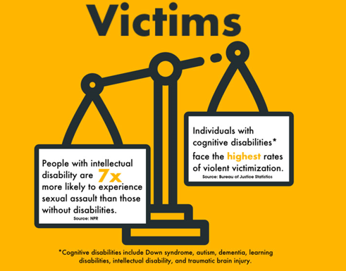
Victimization and IDD
Barriers to Justice
Reports of victimization not believed
Cases may go unprosecuted if there are communication challenges
Inaccessible services and supports
Q&A

Slide 17
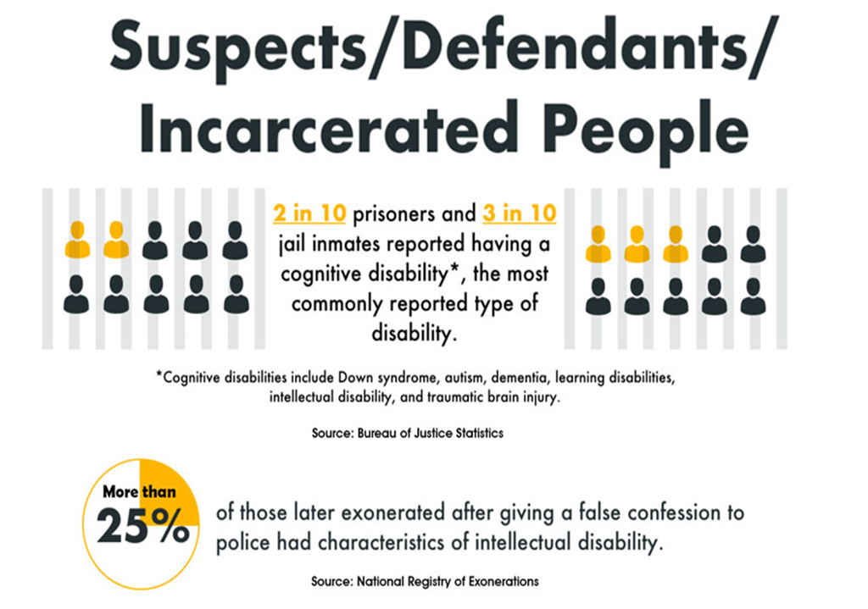
Suspects, Defendants, and Incarcerated People
Suspects/Defendants/Incarcerated People
Barriers to Justice
Disability goes unrecognized or dismissed as irrelevant
Face higher rates of arrest, conviction, and longer sentences
Inaccessible diversion and rehabilitation programs
*Cognitive disabilities include Down syndrome, autism, dementia, learning disabilities, intellectual disability, and traumatic brain injury.
Source: Bureau of Justice Statistics
of those later exonerated after giving a false confession to police had characteristics of intellectual disability.
Q&A
Source: National Registry of Exonerations

Slide 18
Common Interactions with Law Enforcement
Misunderstood, suspicious, strange, or behavior perceived as offensive
Medical emergencies
Victimization
Wandering
Domestic and public disturbances
Q&A

Slide 19
Identification Tips: Communication
Look for…
Limited vocabulary or speech impairment
Difficulty understanding
Short attention span
Mimicking or repetitive speech
Nonsensical speech
Pretending to understand

Slide 20
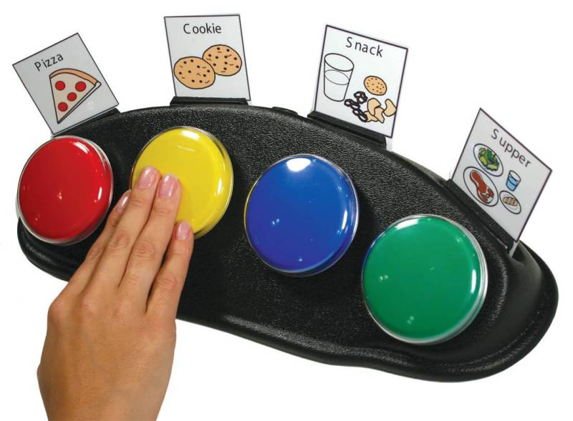
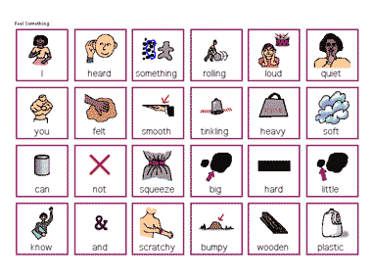
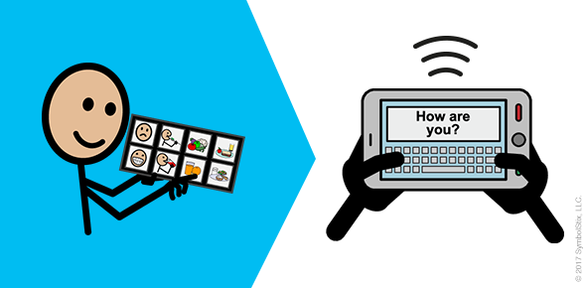
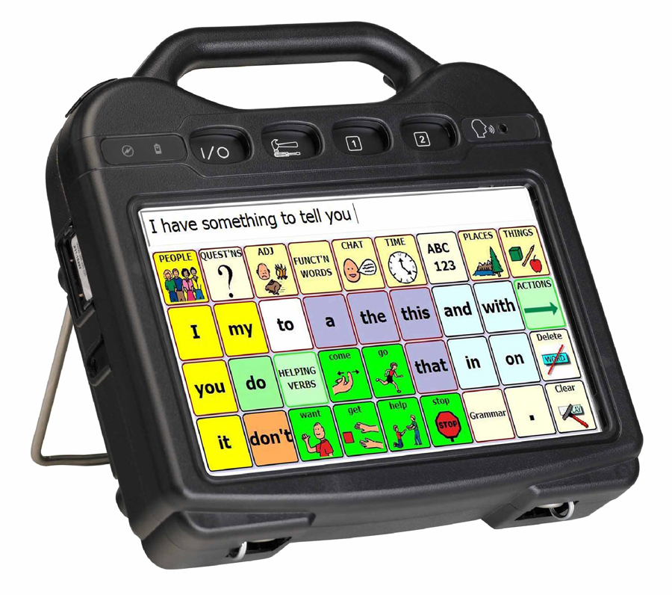
Communication Devices

Slide 21
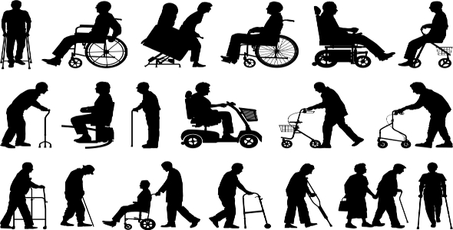
Mobility Assistive Devices

Slide 22
Identification Tips: Behavior
Look for…
Indications that person is easily influenced and/or eager to please
Indications that person is easily frustrated
Difficulty with everyday tasks, such as telling time
Use or request to use assistive devices
Repetitive motions or motor impairment
Q&A

Slide 23
Identification Tips: Interactions with Others
Look for…
Inappropriate interactions with peers
Over-compliance with authority figures
Misunderstanding of social cues and body language
Under or over-engagement with others

Slide 24
Communication Tips
Overview
Logistics and a note on “crisis”
Style and tone
Body language
Interviewing techniques

Slide 25
General Communication Tips
Reminder: People with disabilities are not always in “crisis,” and those without disabilities can be in “crisis”
Logistics
  Quiet place,
  Low distractions,
  Identify yourself and your role

Slide 26
Patience
Person may have more than one disability
Allow for extra processing time for responses and recall of information
Be prepared to repeat yourself
Person may have vocal or other manifestations of their disability
Q&A

Slide 27
Body Language
Use open and clear body language
  Be aware of facial expressions
Keep your hands visible and body relaxed
Explain your actions before you do them
Do not touch the person or make them feel trapped

Slide 28
Style and Tone
Keep sentences short
Use simple, everyday language
Repeat important concepts
Avoid ambiguous phrases
Use pictures, stories, symbols, and actions to help convey meaning
Do not mislead the person

Slide 29

BRIEF ROLE PLAYS FOR DISCUSSION
Law Enforcement Interactions with People with Intellectual and Developmental Disabilities
How would you respond to the following situations?

Slide 30
Wrap-Up & Key Takeaways
Name one basic characteristic of IDD
Describe one strategy that can be used to tell if someone may have an IDD
Name one common interaction people with IDD have with law enforcement
Name one effective communication or de-escalation skill you can use the next time you interact with a person with IDD while working

Slide 31


Module Wrap-Up
Questions?
This curriculum was created through support by Grant No. 2020-NT-BX-K001 awarded by the Bureau of Justice Assistance. The Bureau of Justice Assistance is a component of the Department of Justice’s Office of Justice Programs, which also includes the Bureau of Justice Statistics, the National Institute of Justice, the Office of Juvenile Justice and Delinquency Prevention, the Office for Victims of Crime, and the SMART Office. Points of view or opinions in this document are those of the authors and do not necessarily reflect the official positions or policies of the U.S. Department of Justice.

