Slide 1



Trauma and Post-Traumatic Stress Disorder

Slide 2

Module Overview
What is trauma?
How can trauma affect a person in the short- and long-term?
How might traumatic stress reactions appear on scene?
What approaches can officers use when interacting with someone demonstrating traumatic stress symptoms?

Slide 3
Why Learn About Trauma?
To increase awareness of how common trauma is in the population
To develop understanding and dispel myths
To increase recognition of signs and symptoms of trauma
To reduce re-traumatization
To enhance responses and interactions
Goals of Trauma-Informed Responses
Increase safety of officers, individuals, and community
Provide opportunities for individuals to recover

Slide 4
What is Trauma?
“Individual trauma results from an event, series of events, or set of circumstances that is experienced by an individual as physically or emotionally harmful or life-threatening and that has lasting adverse effects on the individual’s functioning and mental, physical, social, emotional, or spiritual well-being.”
Substance Abuse and Mental Health Service Administration (SAMHSA, 2014)

Slide 5
What Trauma Isn’t…
Trauma ≠ Event
Trauma is a potential reaction to an event or series of events or circumstances.

Slide 6
Potentially Traumatic Events
Being a victim of violence or exposed to violence
Physical, sexual, or psychological abuse
Serious accidents, such as a car crash
Terrorist attack
Combat exposure
Natural disasters, such as hurricanes, floods, fires, or earthquakes
Discrimination
Q&A

Slide 7
Prevalence of Potentially Traumatic Events
Estimates suggest over 80% of U.S. adults are exposed to a potentially traumatic event in their lifetime
  Women are more likely to report experiencing sexual assault and child sexual abuse
  Men are more likely to report experiencing accidents, physical assault, combat, disaster, and violence
More than two-thirds of children report experiencing at least one traumatic event by age 16
Reported rates of exposure to potentially traumatic events are higher among certain groups

Slide 8
Individual Differences in Experiences with Trauma
Risk Factors
Resiliency Factors
Health issues
Mental health conditions
Severity of traumatic event
Proximity to traumatic event
Diminished coping abilities
Biology
Family ties
Strong primary relationship
Connection to community
Employment
Involvement in meaningful activities
Strong cultural/religious beliefs
Biology
Q&A

Slide 9
Trauma is an Injury
Involves experience of helplessness, loss of control, terror
Often results in survival response (fight/flight/freeze)
Creates changes in brain functioning
Causes disruption in physical functioning
Creates changes in thinking, feeling, and behavior

Slide 10
Managing Trauma
Like physical injuries, trauma can…
Be minor with recovery from little effort (walk it off)
Require early intervention to enhance recovery (splint)
Cause serious injury needing treatment (surgery)
Like physical injuries, trauma is something that people can manage and recover from.

Slide 11
Traumatic Stress Symptoms
A common set of symptoms that result from traumatic experience(s)
Re-experiencing – reliving the event, flashbacks, dreams, intrusive thoughts
Avoidance – avoiding situations that are reminders of the event
Hyperarousal – feeling keyed up or jittery, always alert and on the lookout for danger
Negative mood and thoughts – feeling depressed or angry, having negative thoughts about yourself and/or others

Slide 12
What is PTSD?
Post-traumatic Stress Disorder (PTSD) is diagnosed when a certain number of these symptoms are persistent for a certain period of time (typically one month).

Slide 13
Ways People May Develop PTSD
By directly experiencing a traumatic event
By witnessing a traumatic event
By learning that a traumatic event (violent or accidental) occurred to a family member or close friend
By repeatedly hearing the details of a traumatic event

Slide 14
PTSD – How Common is it?
Estimates suggest around 8% of U.S. adults will have PTSD at some point in their lives.
Women are more likely to develop PTSD than men.
The estimated prevalence of PTSD tends to be higher among LGBTQIA+ individuals.

Slide 15

PTSD in Children and Adolescents
Nightmares, flashbacks, avoidance
At risk for substance use
Traumatic play
At risk for impulsive behavior, acting out, and regressive behaviors
  Sexual acting out
  Delinquency
  Fear of sleeping, bedwetting

Slide 16


VIDEO – ACES Overview
Q&A
Notes:
https://www.youtube.com/watch?v=GSKjPFExgX8&ab_channel=CentraCare

Slide 17

PTSD and Trauma Health-Related Risks
Cardiovascular disease
Gastrointestinal issues
Hypertension
Chronic pain
Use of alcohol and drugs
Sleep problems
Mental health conditions
Domestic violence

Slide 18
Universal Experience of Trauma
Recognize that many individuals you meet have likely had traumatic experiences
Ask “What happened to you?”
rather than
“What is wrong with you?”

Slide 19
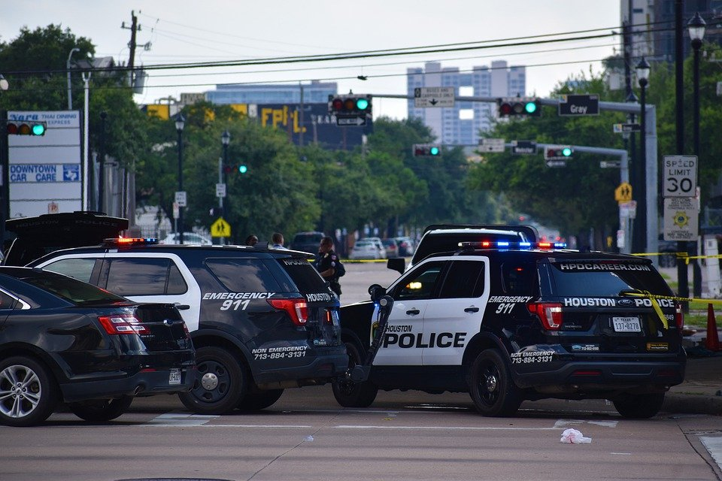
What do traumatic stress reactions look like on scene?
Q&A

Slide 20
Stress
Stressed brains cannot effectively…
      Respond
      Learn
      Process
Allow time to de-escalate!

Slide 21
Tips for Responding
Listen with interest and compassion
Slow the situation down
Show empathy
Be aware of your own body language
To reduce fear, let the person know what you are doing
QUICK TIPS

Slide 22
Tips for Responding
Ask…
  “Are you okay?”
  “What happened to you?”
  “What can I do to help?”
If the person appears to be experiencing a flashback…
  Give them space
  Don’t force them to talk about distressing events
  Gently re-orient them
  (e.g., “We’re in your backyard now…”)
QUICK TIPS
Q&A

Slide 23


Module Wrap-Up
Questions?
This curriculum was created through support by Grant No. 2020-NT-BX-K001 awarded by the Bureau of Justice Assistance. The Bureau of Justice Assistance is a component of the Department of Justice’s Office of Justice Programs, which also includes the Bureau of Justice Statistics, the National Institute of Justice, the Office of Juvenile Justice and Delinquency Prevention, the Office for Victims of Crime, and the SMART Office. Points of view or opinions in this document are those of the authors and do not necessarily reflect the official positions or policies of the U.S. Department of Justice.

