Slide 1



Substance Use Disorders

Slide 2

Module Overview
Substance Use Disorders
  Alcohol
  Cannabis
  Stimulants
  Depressants
  Hallucinogens
  Opioids
Co-Occurring Disorders

Slide 3
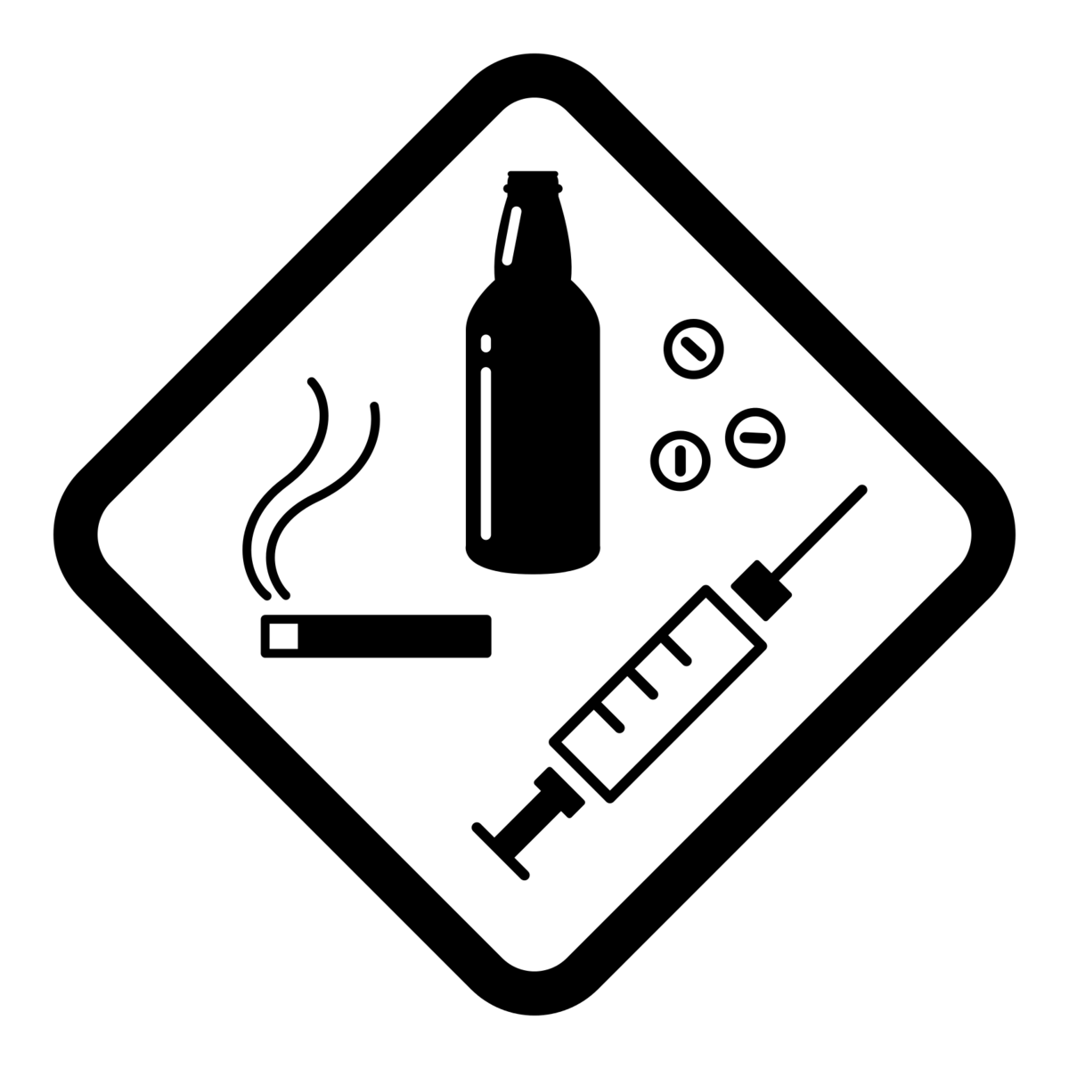
Substance Use Disorders (Part 1)
Substance use disorders range from mild to severe
Extent of use and degree of impairment in life determine the seriousness

Slide 4

Substance Use Disorders (Part 2)
National Prevalence
20.4 million people ages 12+ reported having a substance use disorder in the past year
Results from the 2019 National Survey on Drug Use and Health (SAMHSA)

Slide 5
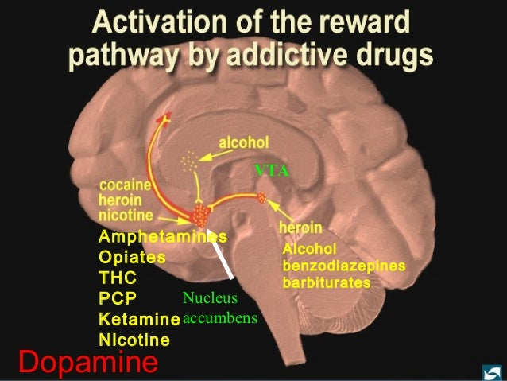
Substance Use Disorders as a Brain Disease

Slide 6
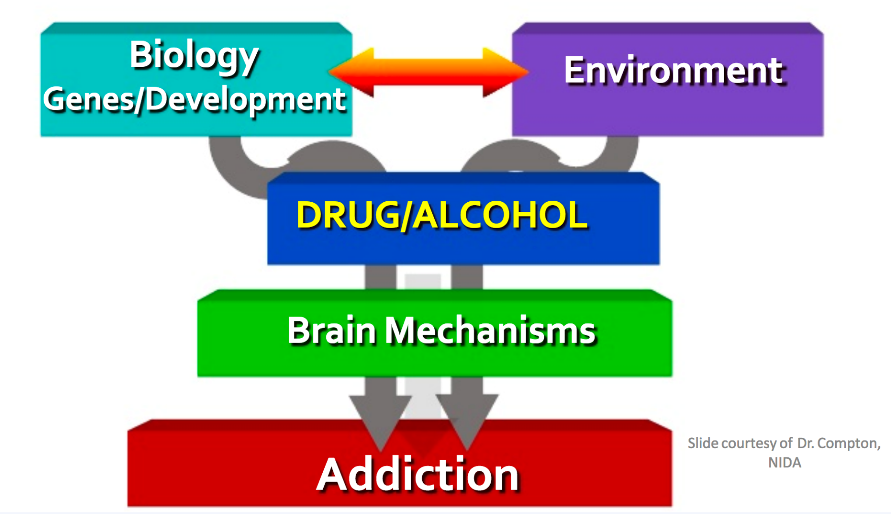
Nature AND Nurture
Environmental Factors
Family Dysfunction
Violence or Abuse
Neglect or Poor Supervision
Easy Access to Drugs
Peer Influence
Trauma or Stressors

Slide 7
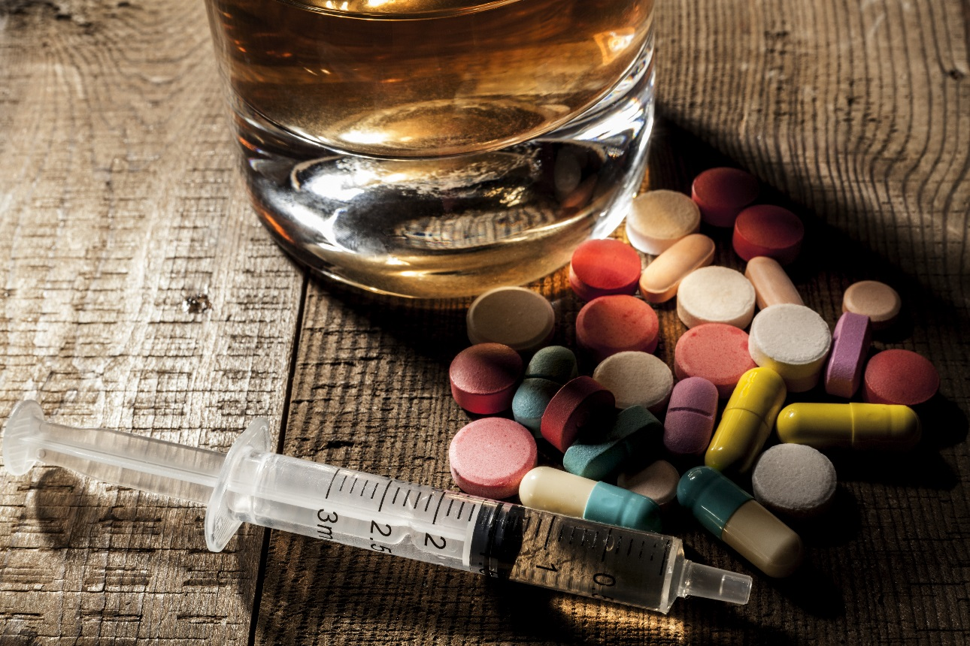
Substance Use Disorders are About
Impaired Control
Social Impairment
Risky Use
Physiological Changes

Slide 8

Substance Use and the Criminal Justice System
Half of those in prison meet the criteria for a substance use disorder
18% of those in prison report their crime was to get drug money
One-third of those in prison report using drugs while committing their crime
70% of those with a mental illness in the criminal justice system, also have a substance use disorder

Slide 9
Tips for Responding
Look for physical evidence of substance use
Ask the person about substances used and when
Consider whether symptoms are from substance use, mental illness and/IDD, or both
Go slow, give space, calming presence, reduce stimulation
Consider the need for medical assistance
QUICK TIPS

Slide 10

Alcohol: Basic Facts
Acute Effects: Disinhibition, euphoria, sedation, slowed reaction time, impaired coordination, lower heart rate and respiration, coma, death

Slide 11
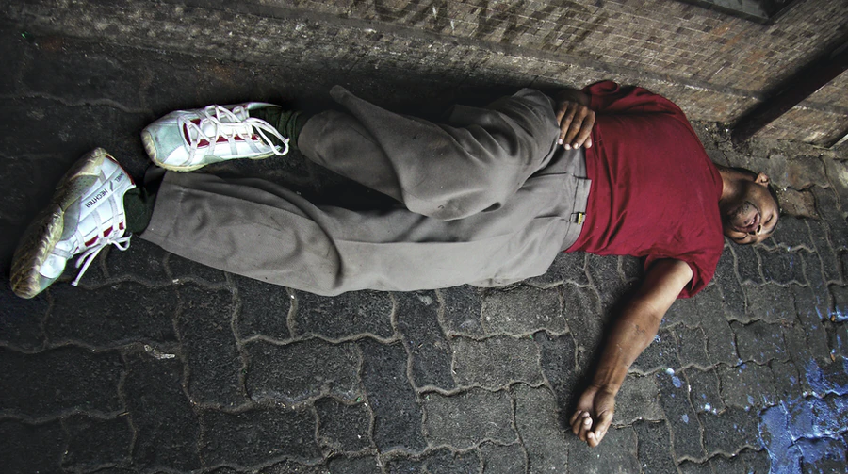
Alcohol Withdrawal
Alcohol Withdrawal Syndrome is comprised of:
Delirium Tremens (DTs)
Convulsions and Seizures
Shakiness and Sweating
Hallucinations
Alcohol withdrawal can be a medical emergency

Slide 12
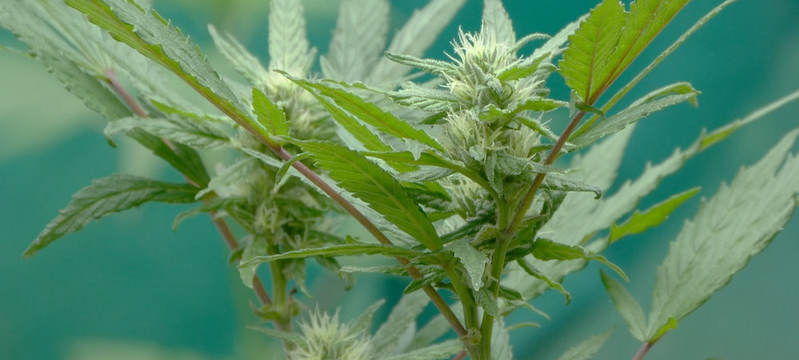
Cannabis: Basic Facts
Acute Effects:
Relaxation
Increased appetite
Dry mouth
Altered time sense
Mood changes
Bloodshot eyes
Paranoid ideation
Impaired memory & cognitive capacity
Difficulty with multistep tasks
Impaired tracking ability
High dose triggers psychedelic effects

Slide 13
Stimulants: Basic Facts
Acute Effects:
Common Stimulants
Cocaine
Methamphetamine
Amphetamines
Prescription stimulants
Increased respiration
Increased physical activity
Decreased appetite
Euphoria
Insomnia
Irritability
Anxiety
Paranoia
Aggressiveness

Slide 14
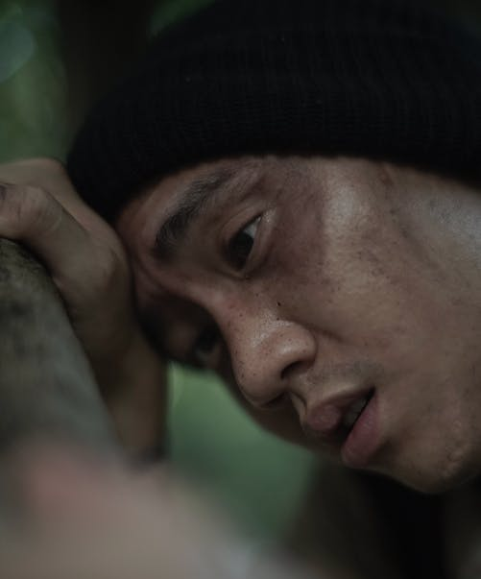
Stimulant Withdrawal
Cravings
Depression
Irritability
Headaches
Exhaustion
Insomnia
Disordered thinking
Psychosis
Dehydration
Muscle spasms
Increased appetite

Slide 15
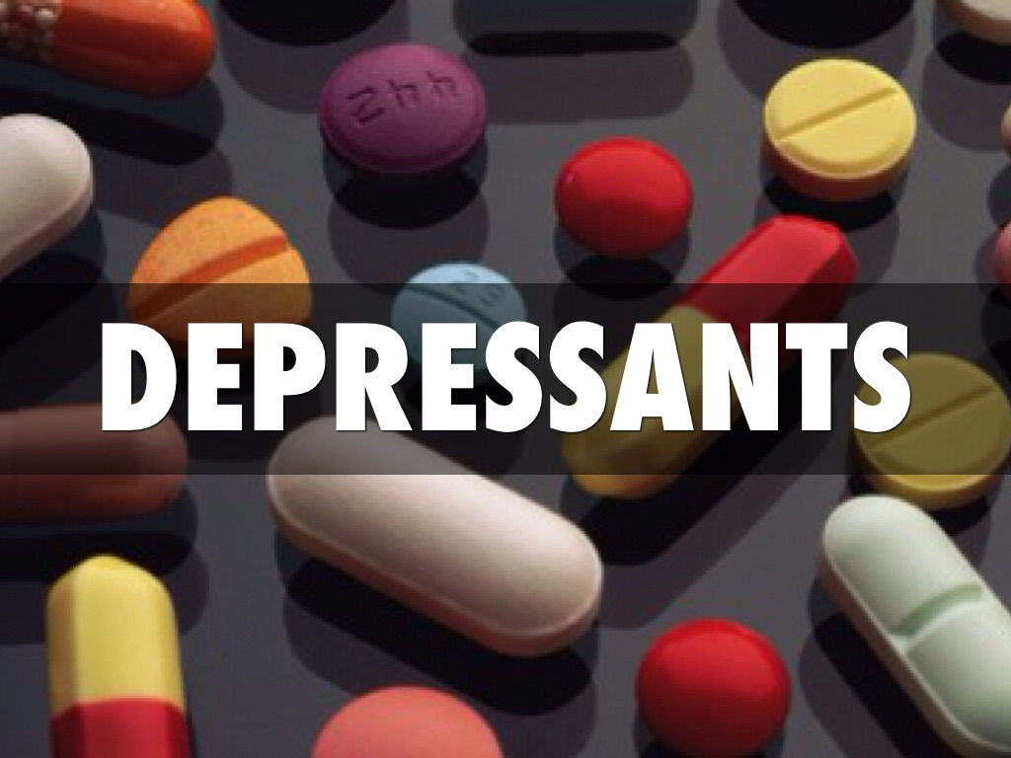
Depressants: Basic Facts
Commonly prescribed benzodiazepines
  Xanax, Valium, Ativan, Klonopin, Librium
Less commonly prescribed barbiturates
  Amytal, Fiorinal, Seconal, Nembutal
Signs of Use: Slow reaction times, confusion, poor coordination, decrease in blood pressure and breathing, sleep or lethargy, dilated pupils
Long-Term Effects: Depression, suicidality, insomnia, breathing difficulties, tolerance and craving

Slide 16
Depressants: Withdrawal and Overdose Risk
Withdrawal
  Intense insomnia
  Nausea
  Physical weakness
  Increased body temperature
  Agitation
  Convulsions
  Seizure-like symptoms
Overdose Risk
  Intentional and unintentional
  Can cause coma or death
  Treatment by medical personnel with Flumazenil
Mental health symptoms are frequently treated with depressant medications. Use or misuse of prescribed medication may result in dependence

Slide 17
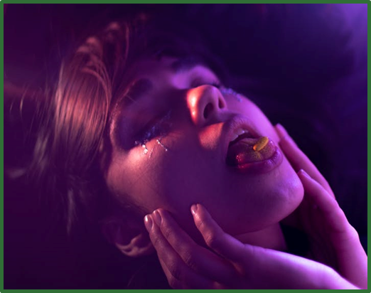
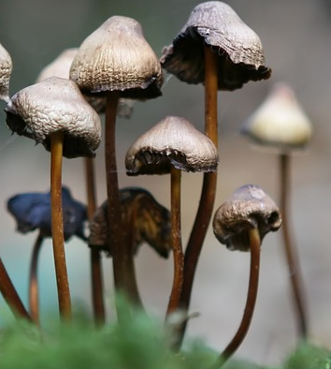
Hallucinogens: The Basics
Description: Alter perception, thoughts, and feelings. Plant derived or synthetic.
Examples of Hallucinogens: Ecstasy, LSD, GHB, DMT, Peyote, Ketamine, PCP, Rohypnol
Acute Effects: Hallucinations, increased heart rate, nausea, intense feelings, altered time perception, increased blood pressure, dry mouth, confused senses (“hearing colors”), paranoia, psychosis

Slide 18
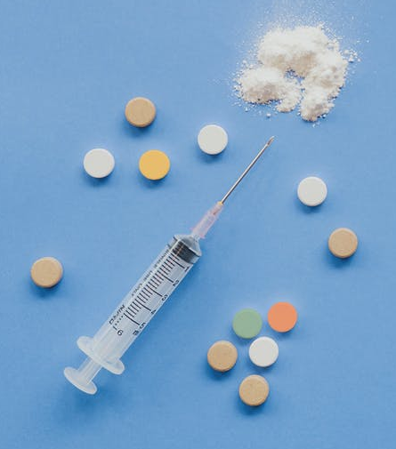
Opioids: Basic Facts
Opioids may be:
Extracted from opium (e.g., morphine, codeine, heroin)
Derived from opium (e.g., oxycodone, hydrocodone)
Synthetically developed (e.g., fentanyl, Demerol)
20-30% of patients prescribed opioids for chronic pain abuse them
Approximately 80% of heroin users first misused prescription narcotics like oxycodone or hydrocodone

Slide 19
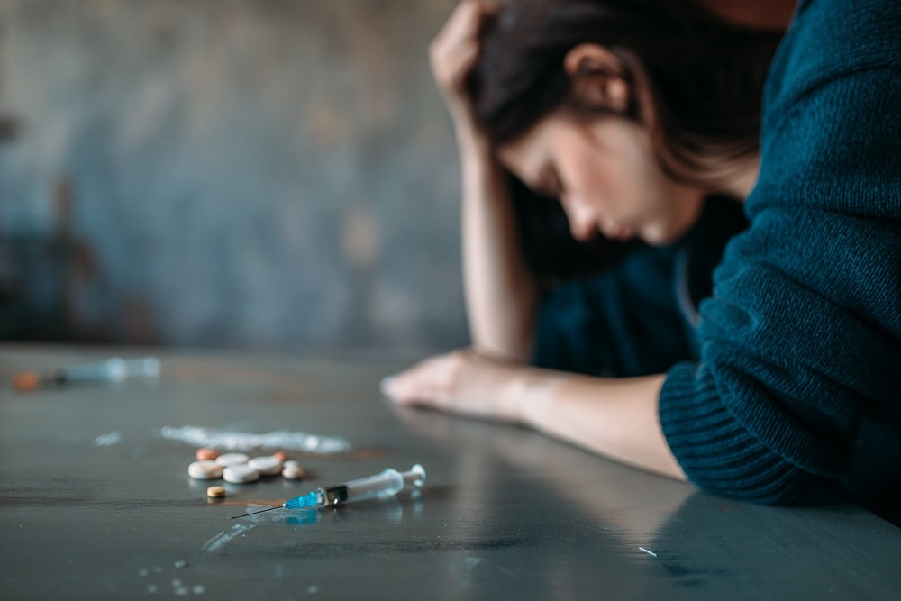
Acute Effects of Opioid Use
Surge of pleasurable sensation
Warm flushing of skin
Dry mouth
Heavy feeling in extremities
Drowsiness (“nodding off”)
Clouding of mental function
Slowing of heart rate and breathing
Nausea, vomiting, and severe itching

Slide 20

Opioid Withdrawal
Withdrawal Symptoms
Nausea and vomiting
Runny nose
Diarrhea
Goosebumps
Cramps
Muscle pain
Restlessness
Sweating
Anxiety
Insomnia
Tremors

Slide 21
Opioid Overdose
Signs of Overdose
  Blue or purplish-black lips or fingernails
  Cold, clammy skin
  Gurgling, snorting, or choking sounds
  Difficulty waking or speaking
  Slow or no heart rate
  Slow or no breathing
  Limp body
  Pinpoint pupils
What to do
  Call emergency medical response
  Administer naloxone (Narcan)
  Perform rescue breathing
  Force wakefulness

Slide 22
Co-Occurring Conditions:
Substance Use and Mental Illness
MENTAL ILLNESS
SUBSTANCE USE PROBLEMS
3X RISK
MAKES
WORSE
MENTAL ILLNESS
SUBSTANCE USE PROBLEMS
Need to TREAT BOTH for improvement

Slide 23

Why do people living with mental illness use substances?
Self-medication
Easier to get drugs/alcohol than prescription medications
Cost of medications, no insurance
Delay in medication working
Poor judgment
High need for excitement, thrills, risks
Social influences

Slide 24
Co-Occurring Conditions:
Substance Use and IDD
Basic Facts:
Approximately 5% of those with IDD have a substance use disorder
Most used substances include alcohol, tobacco, and cannabis
Substance use disorders are not always recognized in this population
Consequences include…
Increased social isolation
Problems with the criminal justice system
Victimization while under the influence
Increased cognitive problems
Poor impulse control
Life-threatening side effects from interaction with other medication

Slide 25
Why do people with IDD use substances?
People with milder IDD have greater independence allowing for access to substances
More susceptible to peer pressure
Often there is a co-occurring mental illness
Use substances to cope with negative experiences

Slide 26
Co-Occurring Conditions: Challenges in Providing Care
Difficulty determining the cause of symptoms
Uncertainty as to the most critical need
Difficulty deciding the most appropriate service providers
Both have a high rate of relapse
Both include crisis behaviors
Both are high-need consumers of services
Both have frequent arrest and justice involvement

Slide 27
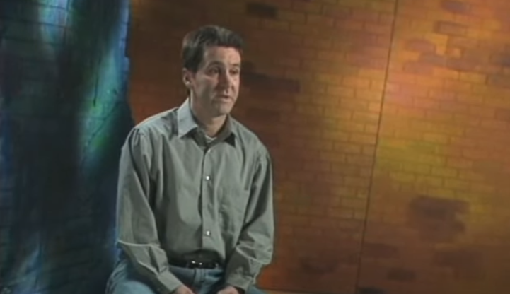
Video: Adults and Co-Occurring Disorders
Notes:
Video Activity: “Adults and Co-occurring Disorders” (4:14)
https://www.youtube.com/watch?v=4xyaQbTeg74&ab_channel=reelizations
This video provides insight into the experiences of people living with co-occurring disorders and highlights the variation in these experiences across different people.

Slide 28
Treatment
Treatment for Substance Use Disorders
Individual and group counseling
Inpatient and residential treatment
Intensive outpatient treatment
Medication
Partial hospital programs
Case or care management
Recovery support services
12-Step fellowship programs
Peer supports

Slide 29
Evidence-Based Treatment Components
Behavioral Treatment
Individual, Group and Family Counseling
Motivation Enhancement
Cognitive Behavioral
Contingency Management
Relapse Prevention
Medication-Assisted Treatment (MAT)
Disulfiram
Acamprosate
Naltrexone/Vivitrol
Opioid Replacement
  Methadone
  Buprenorphine
Re-entry and Support
Peer Support
Support Groups
Housing
Employment Services
Case Management
Counseling

Slide 30
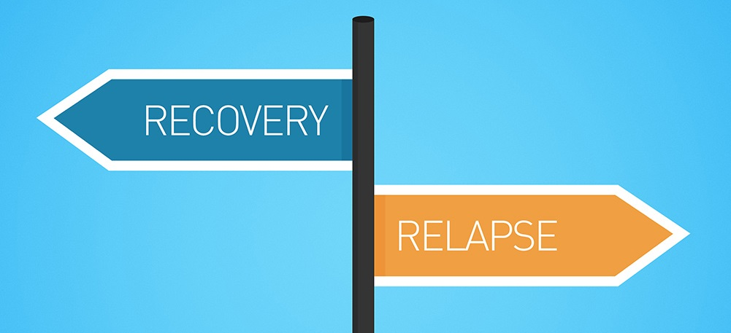
Recovery and Relapse

Slide 31
Tips for Responding
Look for physical evidence of substance use
Ask the person about substances used and when
Consider whether symptoms are from substance use, mental illness and/IDD, or both
Go slow, give space, calming presence, reduce stimulation
Consider the need for medical assistance
QUICK TIPS

Slide 32


Module Wrap-Up
Questions?
This curriculum was created through support by Grant No. 2020-NT-BX-K001 awarded by the Bureau of Justice Assistance. The Bureau of Justice Assistance is a component of the Department of Justice’s Office of Justice Programs, which also includes the Bureau of Justice Statistics, the National Institute of Justice, the Office of Juvenile Justice and Delinquency Prevention, the Office for Victims of Crime, and the SMART Office. Points of view or opinions in this document are those of the authors and do not necessarily reflect the official positions or policies of the U.S. Department of Justice.

