Slide 1



Understanding Mental Health Conditions & Mental Illnesses

Slide 2

Module Overview
Mental Health Conditions & Mental Illnesses
Role of Medication in Treatment
Mental Illnesses – What They Look Like
  Mood Disorders
  Anxiety Disorders
  Psychotic Disorders
  Disruptive and Impulse Control Disorders (youth)
Tips for Responding

Slide 3
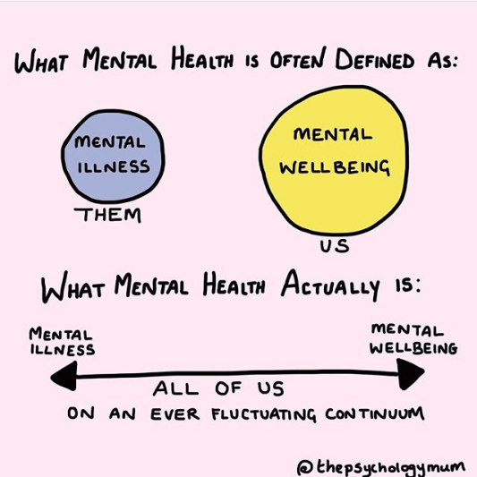
What is Mental Health?
Q&A

Slide 4
Mental Health Conditions & Mental Illnesses
Mental health conditions are a wide range of conditions that can affect mood, thinking, and/or behavior. These conditions can be mental, behavioral, or emotional.
Mental illnesses refer to diagnosable medical conditions that involve changes in cognition, thinking, and/or behavior. Mental illnesses are associated with psychological distress and/or difficulties with functioning in daily activities.
Symptoms such as stress, anxiety, depression, and trauma may be temporary, but they also can become serious and chronic.

Slide 5
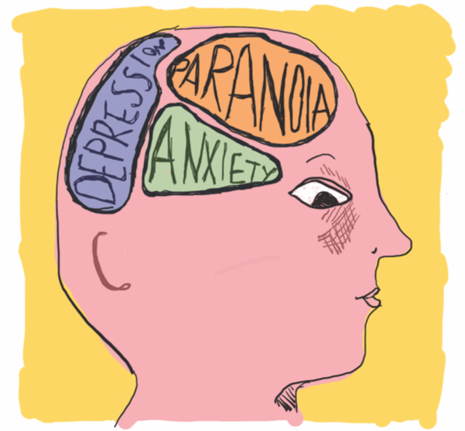
What is a Mental Illness?
Mental, behavioral, or emotional disorder resulting in problems with feeling, thinking, and behaviors that significantly and negatively impact the ability to relate to others and/or function.

Slide 6
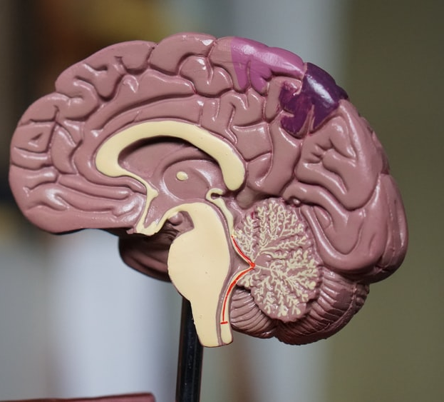
Causes of Mental Illnesses
Early adverse life experiences
Experiences related to chronic medical conditions
Biological factors/chemical imbalances in the brain
Substance use
Environmental stressors (can trigger)

Slide 7

Mental Illness & Violence
Most people with a mental illness are not violent, yet risk factors exist
Most people who are violent have no history of mental illness
Those with serious mental illness are much more likely to be victims of violence than perpetrators

Slide 8
Treatment, Services, & Support
Treatment
Medication
Inpatient Hospitalization
Therapies
  Individual
  Group
  Family
Support
Peer Support
Case Management
Supported Housing
Supported Employment

Slide 9

MEDICATION
Q&A

Slide 10
Medication Adherence Issues
People may stop taking their medications because:
Too expensive or lack insurance
Stigma
Belief the medication does not work at all or quickly enough
They feel better and believe they don’t need to take medication anymore
The dose and/or frequency is burdensome
No social support system
Homelessness
Difficulty getting their medications or keeping them safe
Side effects (highlighted)
Q&A

Slide 11



Common Side Effects
Dizziness, drowsiness
Weight gain
Shaking/tremors
Loss of appetite
Dry mouth
Constipation
Sleep difficulties
Sexual dysfunction
Anxiety, agitation, and/or irritability
Involuntary movements
Type 2 Diabetes
Q&A

Slide 12
Tips for Interaction – Medication
Ask about medications: What are they used for? When did they last take them?
Acknowledge that side effects can be troubling
Be aware of unpredictable behaviors if off medication
Consider medical emergencies
Remember that medication is NOT a cure-all. Avoid statements like “Why don’t you just take your meds?”
QUICK TIPS

Slide 13
UNDERSTANDING MENTAL HEALTH CONDITIONS
What you may see during a crisis

Slide 14

Mental Illness/Mental Health Conditions Often Responded To
Depression – negatively affects how you feel, the way you think, and how you act
Bipolar Disorders – cause extreme mood swings from depression to mania
Anxiety Disorders – intense, excessive, and persistent worry and fear about everyday situations
Psychotic Disorders – cause abnormal thinking and perceptions; loss of touch with reality
Disruptive and Impulse Control Disorders (Children and Youth) – problems with emotional and behavioral self-control and self-regulation

Slide 15
Common Signs or Symptoms of Mental Illnesses
What you may see or experience:
Fight or Flight
Slow to process information
Difficulty communicating
Distracted; fearful
Impulsivity; aggression
Irritability, worsening of symptoms
Attempts at self-harm
Increased unpredictability
Excessive feelings of fear or worry
Confused and/or irrational thinking
Hallucinations and/or delusions
Intense emotions and/or mood swings
Sleep issues
Suicidal thoughts and/or behavior
Substance use

Slide 16

Understanding Psychosis
Psychosis is a loss of contact with reality.
The ability to perceive and respond to the environment is significantly disturbed
Functioning is impaired
Symptoms may include delusions and/or hallucinations
People experiencing psychosis may be very frightened
Q&A

Slide 17
Understanding Psychosis: Delusions
A persistent, false belief regarding the self or persons or objects outside of the self that is maintained despite indisputable evidence to the contrary
The content of delusions has a variety of themes: persecutory, referential, somatic, religious, grandiose
Bizarre delusions usually express a loss of control over the mind or body

Slide 18

Understanding Psychosis: Hallucinations
Perception-like experiences that occur without an external stimulus
Usually vivid, clear, and not under voluntary control
Auditory hallucinations are the most common
Voices may be derogatory or commanding
Someone experiencing hallucinations may have a hard time filtering out irrelevant information

Slide 19
Psychotic Disorders – Schizophrenia
Typically emerges in late adolescence/early adulthood and is a chronic life-long illness with some periods of remission
Estimates suggest that 0.3–0.7% of people may experience this disorder at some point in their lives
Presents equally across sexes
Q&A

Slide 20
Schizophrenia
Delusions
Hallucinations
Disorganized thinking
Very disorganized or abnormal motor behavior (e.g., too much or too little body movement)
Apathy
Lack of emotion
Poor social functioning
Symptoms of Schizophrenia

Slide 21
Schizophrenia – Disorganized Thinking
Did you know loitering is against the law?
I don’t want to go to jail. Jail is for the birds. One time I saw birds flying around in the jail. Birds should be out in the air. The air is dirty in Chicago. All these big buses. I ride the bus to get my groceries. Jewel is my favorite store.

Slide 22
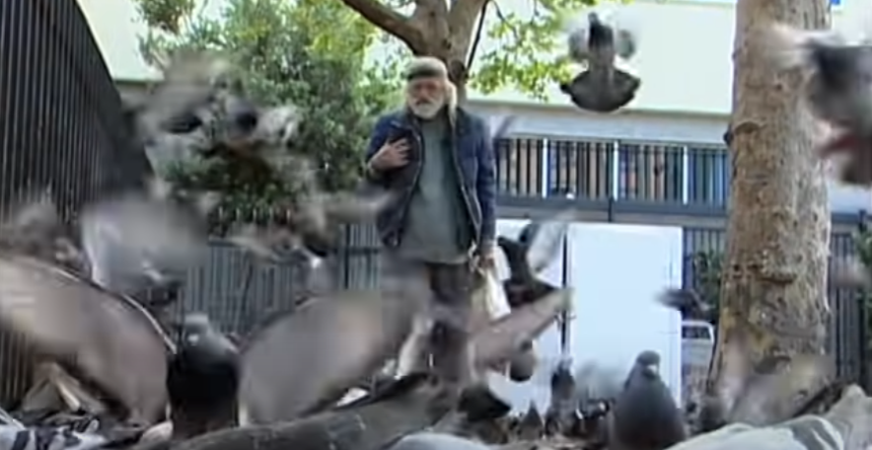

Video Activity – Schizophrenia Part 1
Q&A
(10:19)
Notes:
https://youtu.be/rCbf-pKtkhU (10:19)

Slide 23
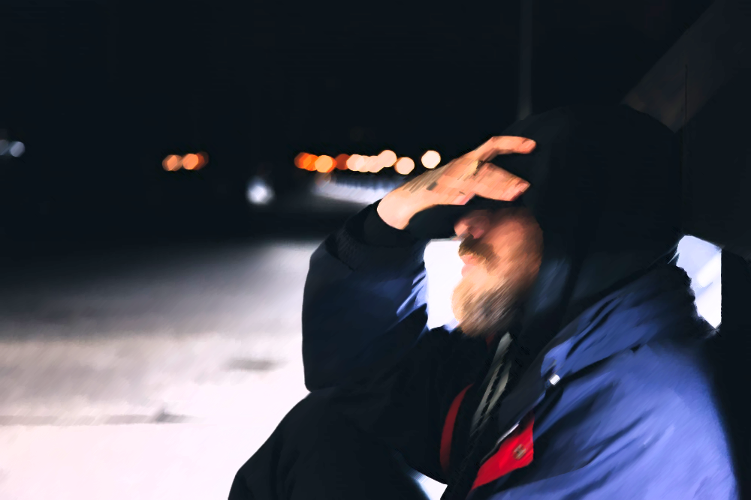
Activity
HEARING VOICES
Q&A

Slide 24
Hearing Voices Drawing Activity

Slide 25
Tips for Responding to Mental Health Crises

Slide 26
Things to Remember When Responding
Maintain Safety
People typically fight or flee (“flight”) when scared
Reasoning with a person in crisis is difficult
Reduce the level of arousal to avoid escalation
Be aware of your body language, tone, and attitude
Be active in helping
  How can I help? Who else can help?
QUICK TIPS

Slide 27
Tips for Responding
Slow things down
Be patient; Allow time for the person to respond
Be repetitive with information and instructions
Acknowledge and validate their feelings
Avoid sudden movements; Reduce distractions
​Set clear, consistent limits and boundaries
Give choices
Inquire about sleep issues, medication
QUICK TIPS
Q&A

Slide 28
Additional Tips for Responding
For Depression: Be aware of suicide risk
For Bipolar Disorder: Be aware of sudden irritability/impulsivity; avoid arguing; minimize interruptions; allow pacing, if safe
For Anxiety: Encourage the person to breathe slowly to calm down
For Psychosis/Schizophrenia: Keep their focus on you; use their name frequently; limit interaction to just one officer
For Conduct/Impulse Control Disorders: Consider that trauma may be a part of this person’s life; use age-appropriate language; remember kid’s brains are different
QUICK TIPS

Slide 29

Case Scenarios

Slide 30


Module Wrap-Up
Questions?
This curriculum was created through support by Grant No. 2020-NT-BX-K001 awarded by the Bureau of Justice Assistance. The Bureau of Justice Assistance is a component of the Department of Justice’s Office of Justice Programs, which also includes the Bureau of Justice Statistics, the National Institute of Justice, the Office of Juvenile Justice and Delinquency Prevention, the Office for Victims of Crime, and the SMART Office. Points of view or opinions in this document are those of the authors and do not necessarily reflect the official positions or policies of the U.S. Department of Justice.

