Slide 1
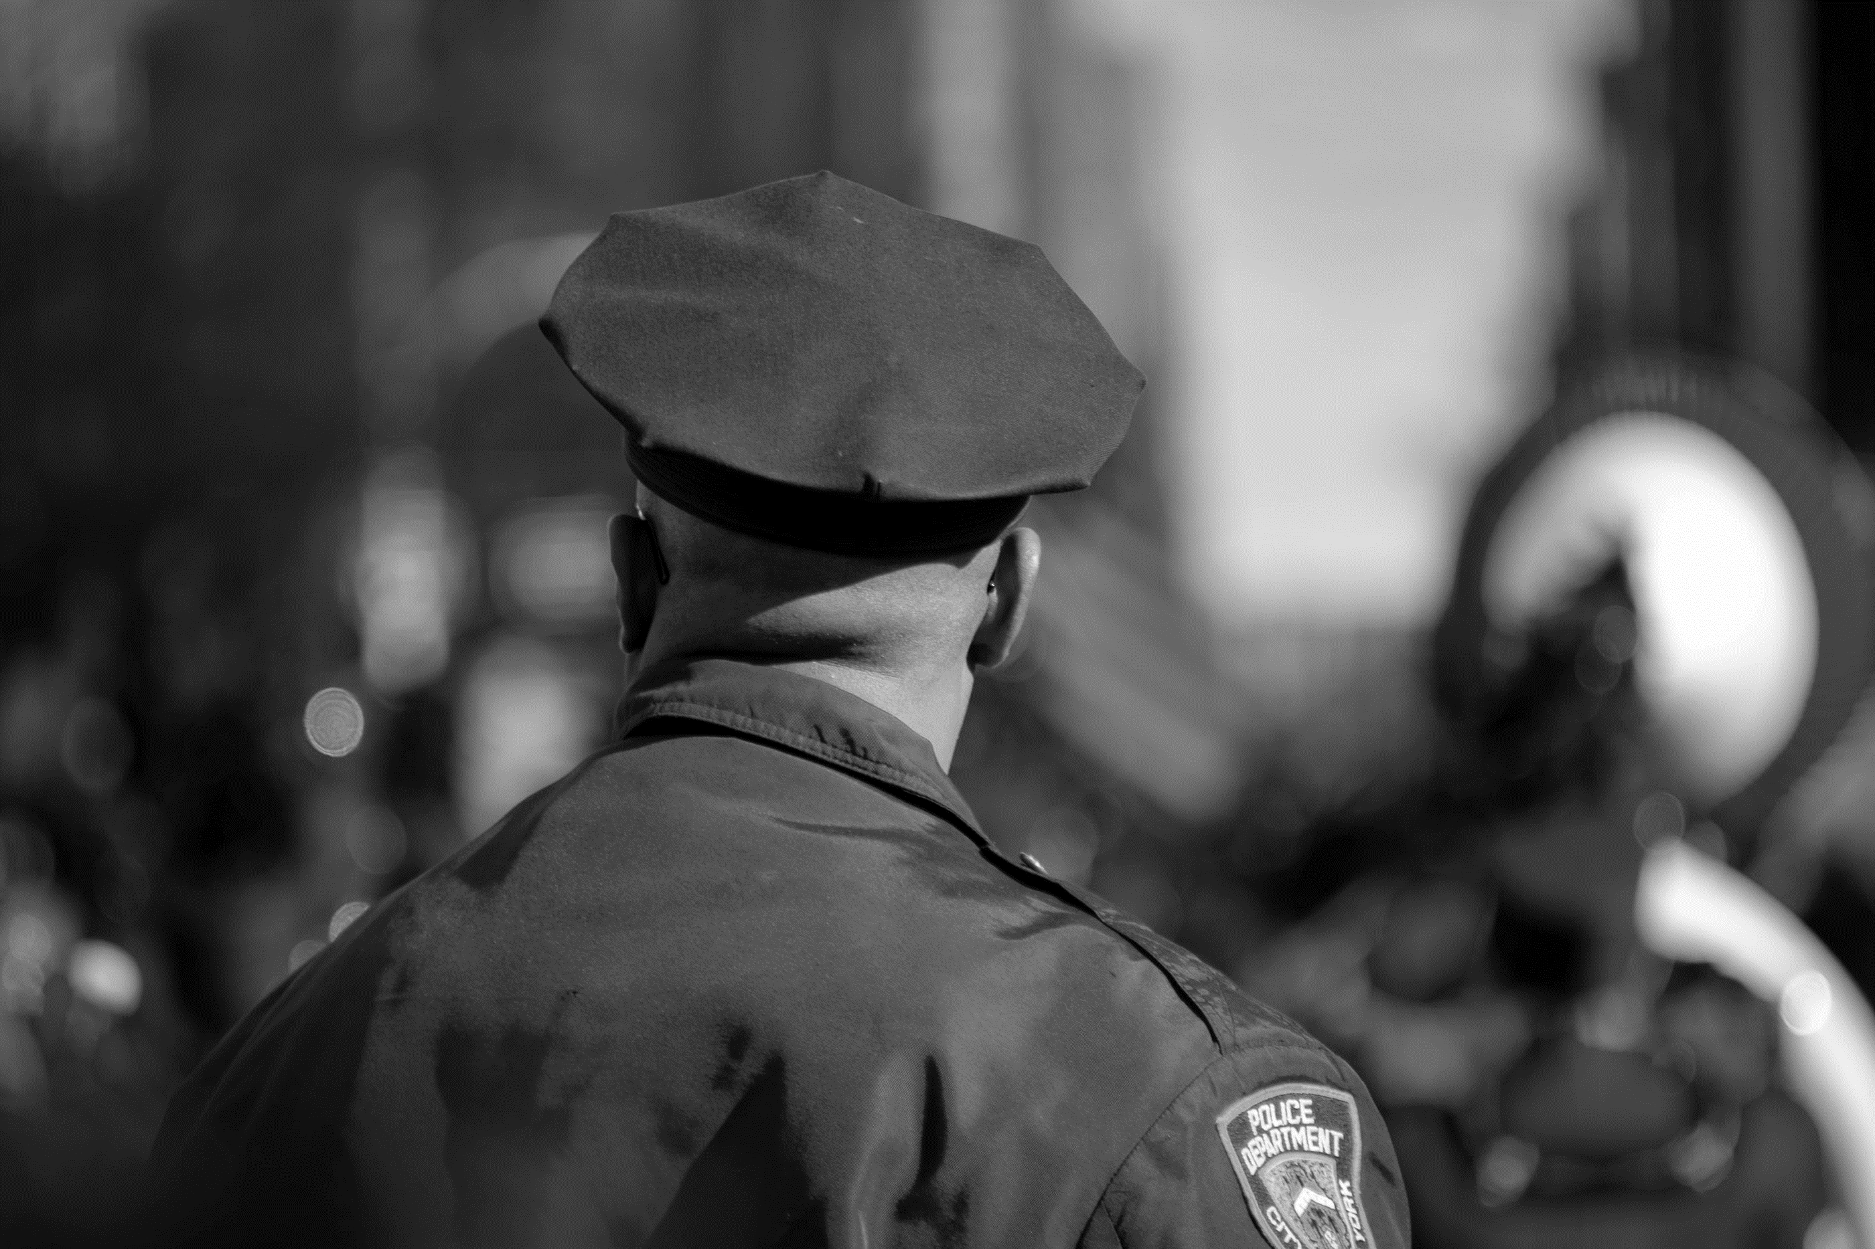


Prioritizing Officer Mental Health, Wellness, and Resilience

Slide 2

Module Overview
Impact of stress and trauma
Preventing officer suicide
Tips to promote self-awareness and awareness in colleagues and peers
Strategies to build personal resilience
Available services and resources to support mental health and wellness

Slide 3
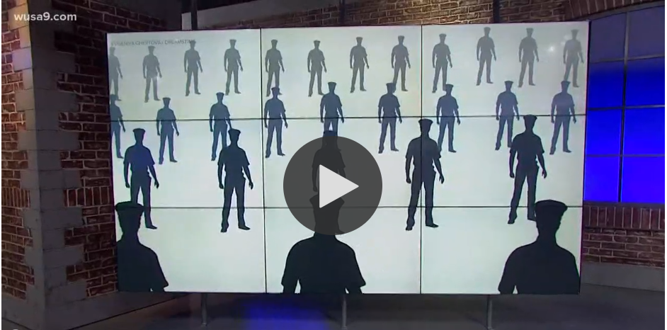

Four Police Officers, Four Different Ways to Cope with Suicide and Mental Health
Notes:
https://www.wusa9.com/embeds/video/65-83d252c1-2150-4927-a487-bd317e8dae8e/iframe?jwsource=cl

Slide 4

Realities of the Job
Police work is characterized by physical and psychological dangers
Cumulative exposure can affect officers’ mental well-being and physical health
Experiences found to impact traumatic stress symptoms, substance use, depression, and suicidal ideation

Slide 5
Understanding Stress
Stress generally refers to two things:
The psychological perception of pressure, and
The body’s response to it, which can involve multiple systems such as metabolism, muscles, and memory
Chronic stress is the response to this pressure over a prolonged period where an individual feels they have no control

Slide 6
Police Officers and Traumatic Stress
“Individual trauma results from an event, series of events, or set of circumstances that is experienced by an individual as physically or emotionally harmful or life-threatening and that has lasting adverse effects on the individual’s functioning and mental, physical, social, emotional, or spiritual well-being.” (SAMHSA, 2014)
Key symptoms of traumatic stress:
Re-experiencing or reliving the event
Avoidance of situations that are reminders of the event
Hyperarousal
Negative mood and thoughts
Psychological trauma is an injury from which people can recover

Slide 7
Managing Stress
Healthy Activities | Unhealthy Coping Mechanisms
Refocusing on your purpose Taking care of your body Connecting with others Practicing mindfulness Seeking help | Uncontrollable eating or dieting Excessive use of alcohol Misuse of medication; Use of illicit drugs Excessive shopping Overworking
Q&A

Slide 8
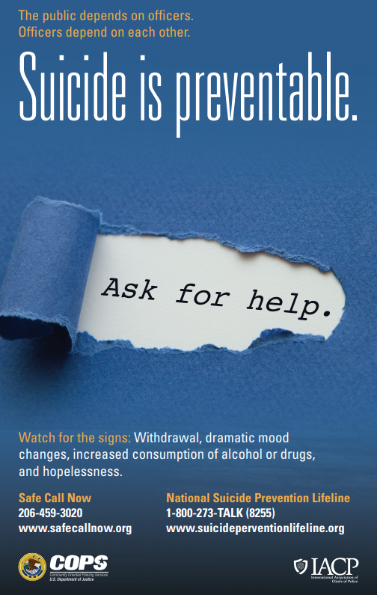
Preventing Officer Suicide (Part 1)
Since 2016, more law enforcement officers have died by suicide than were killed in the line of duty.
Police officers have a heightened risk for suicide, but also have factors that can protect them from suicidal thoughts and behaviors.
Suicide is preventable.

Slide 9
Preventing Officer Suicide (Part 2)
Protective Factors | Risk Factors
Resilience Connectedness Social and peer support Coping and problem-solving skills Ability to adapt to change Self-esteem and sense of purpose or meaning in life Culturally appropriate mental health and wellness services Sources of continued care | Previous suicide attempt Mental health condition Substance use disorder Access to lethal means (e.g., firearm) Social isolation Chronic disease or disability History of physical or sexual abuse Family history of suicide Exposure to traumatic events in adulthood

Slide 10
Warning Signs of Suicide
  IMMEDIATE RISK
  Respond immediately if you observe any of the following behaviors:
  Talking about wanting to die or killing oneself
  Talking about feeling hopeless or having no reason to live
  SERIOUS RISK
  Talking about feeling trapped or in unbearable pain
  Acting anxious or agitated, behaving recklessly
  Withdrawing or feeling isolated
  Displaying extreme mood swings

Slide 11
The Roles of Peers in Suicide Prevention
Be aware. Learn the warning signs of suicide.
Get involved. Become available. Show interest and support.
Be direct. Talk openly and freely about suicide.
Be willing to listen.
Be non-judgmental.
Offer empathy.
If someone expresses that they are struggling, do not act shocked.
Do not be sworn to secrecy. Seek support.
Offer hope that alternatives are available.
Act.

Slide 12

Officer Resilience
Having the skills to navigate adversity and grow in the face of challenges, also known as resilience, can lead to improved mental health and physical wellness.
In law enforcement, resilience can be viewed as the ability to adapt to and overcome the effects of the stress and trauma associated with police work.
RESILIENCE

Slide 13



Officer Resilience: Connection
Connect with others by maintaining social relationships with those close to you. Set aside time to communicate with friends and family to keep your support system informed and strong.
Q&A

Slide 14




Officer Resilience: Balance
Q&A

Slide 15


Officer Resilience: Health
Take care of your body by maintaining healthy habits, such as:
Eating nutritious foods; Balanced diet
Staying hydrated by drinking 8-10 glasses of water each day
Exercising regularly
Getting plenty of sleep
Avoiding nicotine and excessive alcohol intake
Q&A

Slide 16
Officer Resilience: Mindfulness
Mindfulness – Focusing attention on experiences occurring in the present moment
Can assist with stress management and ability to cope with trauma or crisis
Practice mindfulness by taking short breaks to reset and recognize what you need to do to cope with your emotions

Slide 17

Accessing Support and Services
Insert local resources, highlighting:
Department resources
Local government and community resources
Crisis and suicide prevention hotlines

Slide 18


Module Wrap-Up
Questions?
This curriculum was created through support by Grant No. 2020-NT-BX-K001 awarded by the Bureau of Justice Assistance. The Bureau of Justice Assistance is a component of the Department of Justice’s Office of Justice Programs, which also includes the Bureau of Justice Statistics, the National Institute of Justice, the Office of Juvenile Justice and Delinquency Prevention, the Office for Victims of Crime, and the SMART Office. Points of view or opinions in this document are those of the authors and do not necessarily reflect the official positions or policies of the U.S. Department of Justice.

