Slide 1
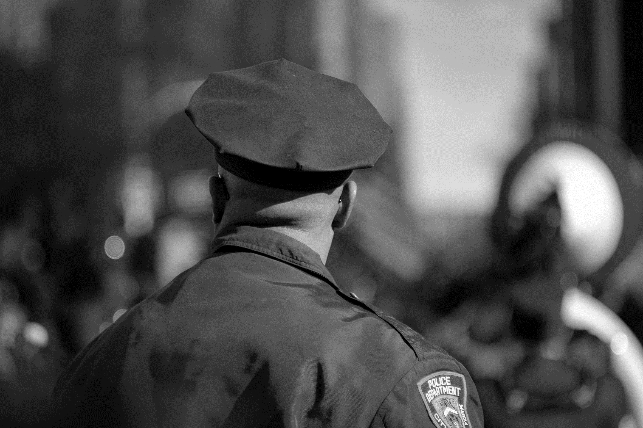


Perceptions and Attitudes on Behavioral Health and Disabilities

Slide 2

Module Overview
Perceptions and Attitudes
Understanding Disability
Principles of Recovery
Disability Community Values and Culture

Slide 3


What Do People Say Or Think?
Q&A

Slide 4
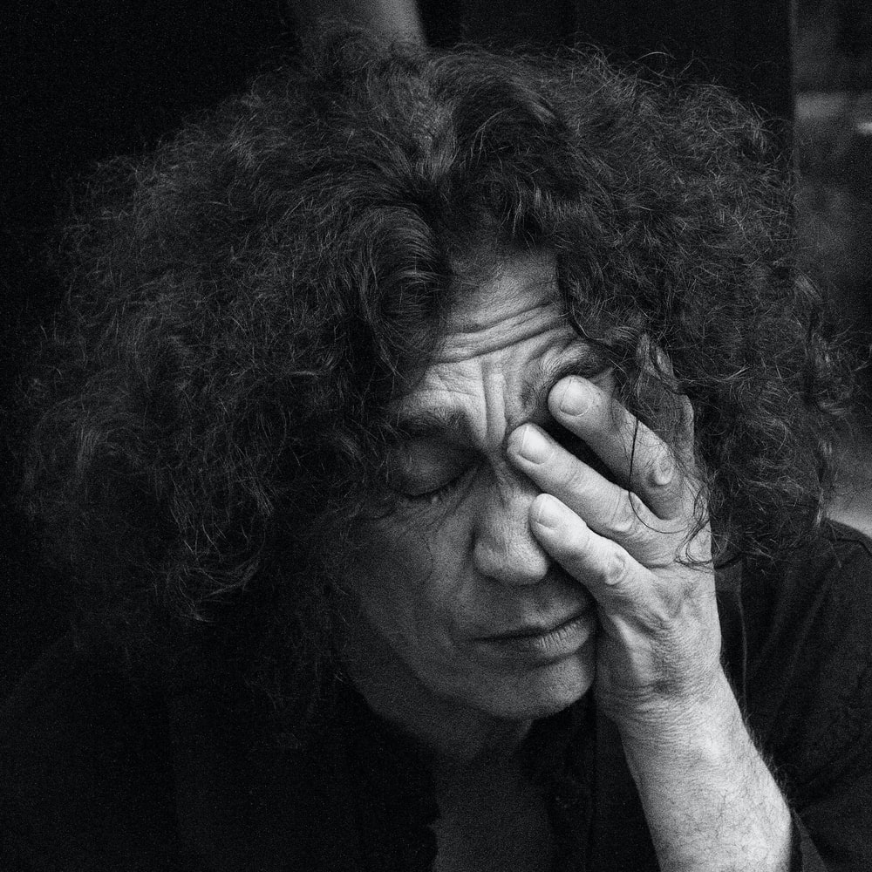
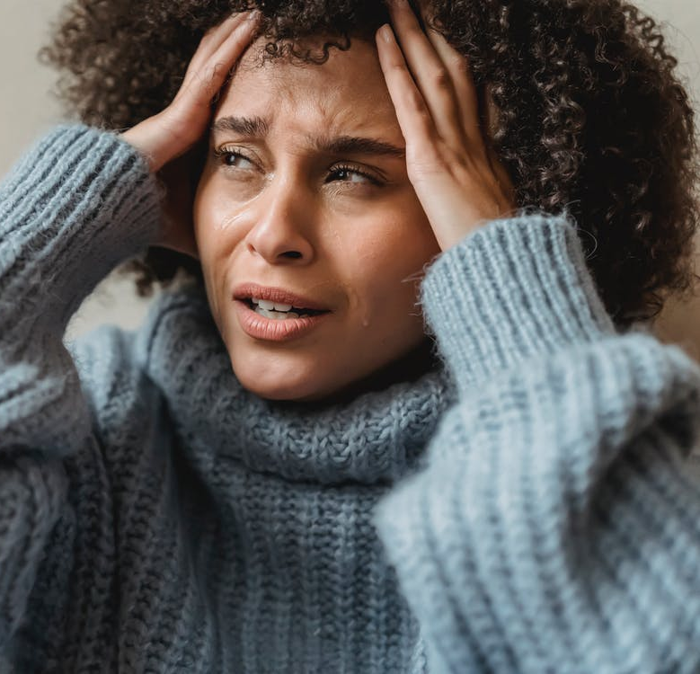

Mental Health Conditions

Slide 5
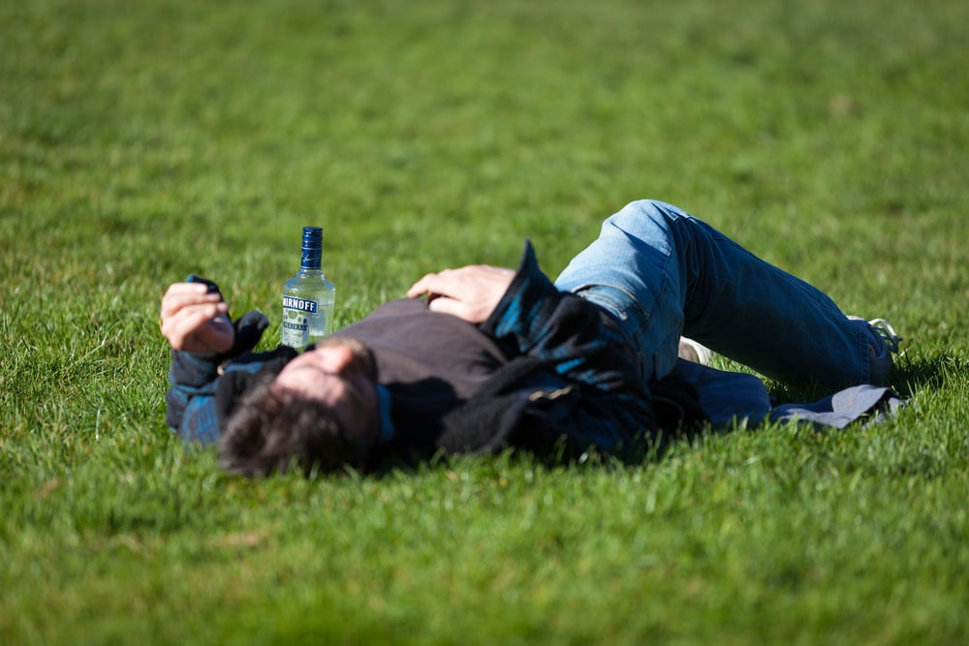
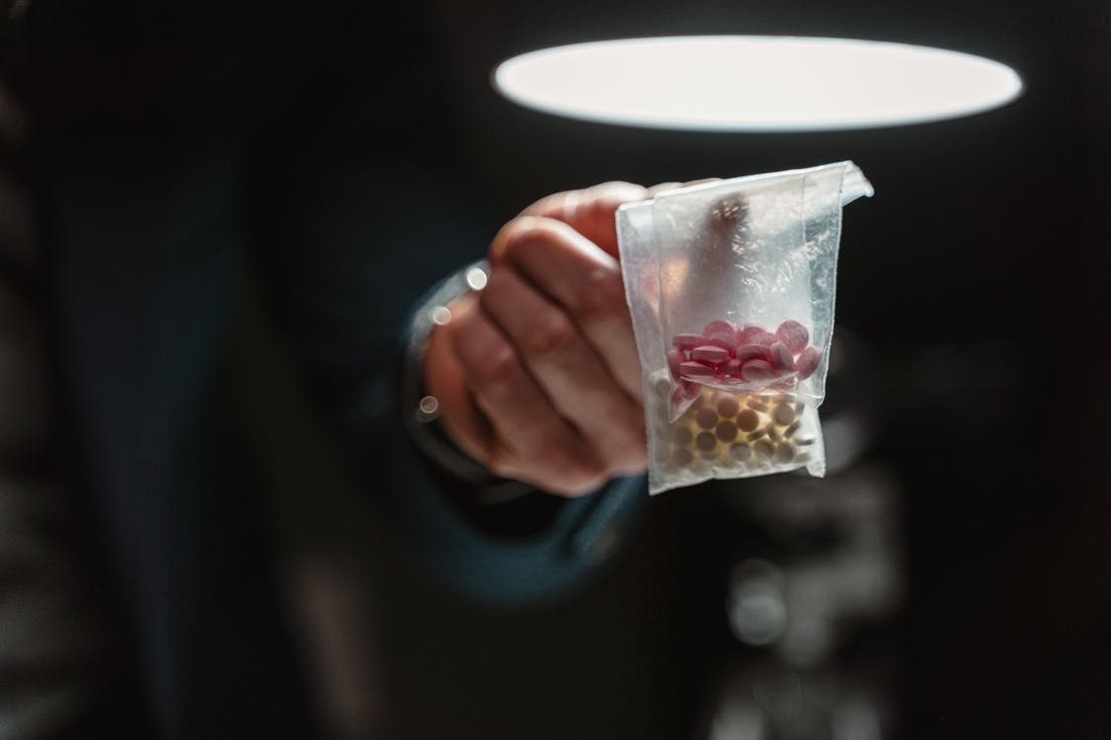
Substance Use Disorders

Slide 6
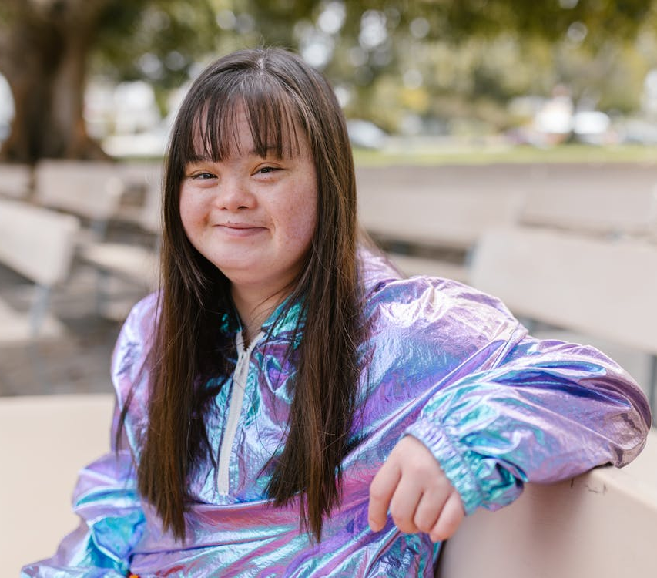
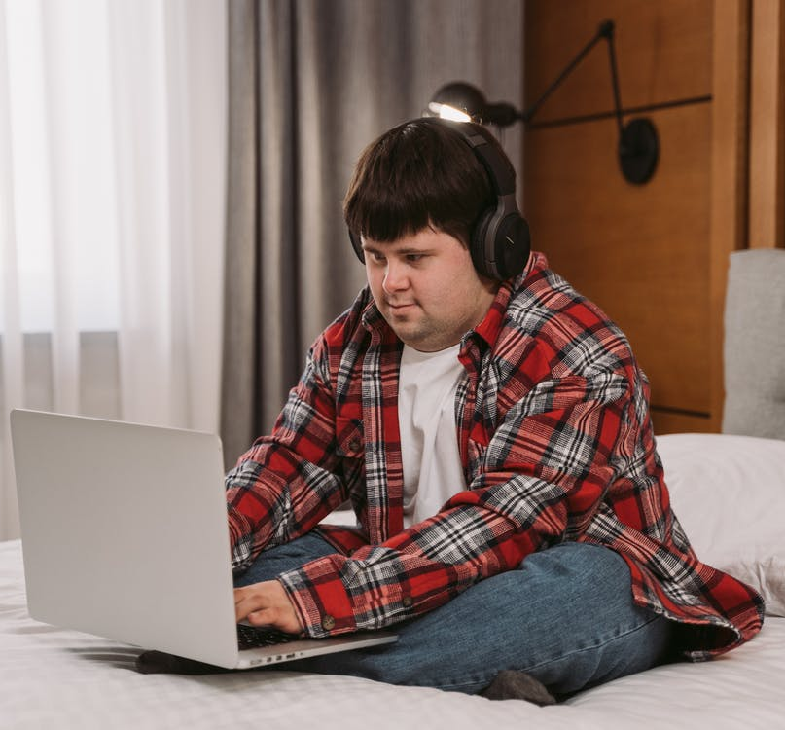

Intellectual Disabilities

Slide 7
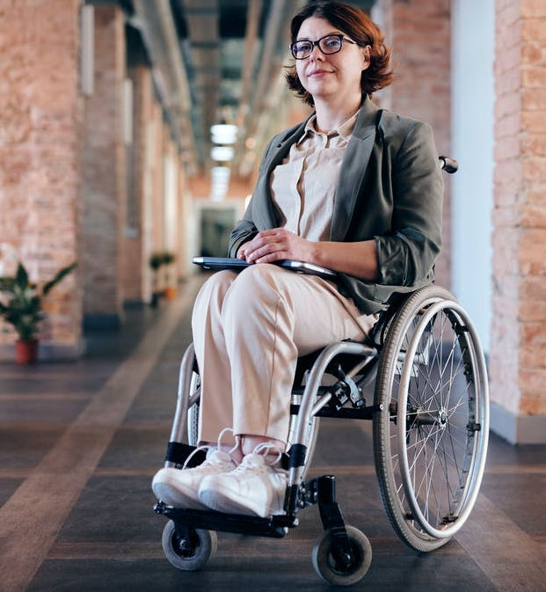
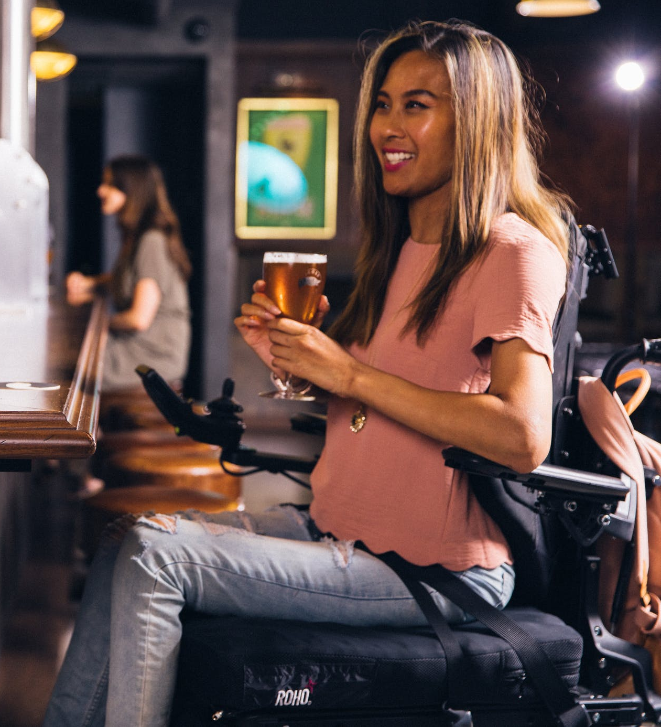
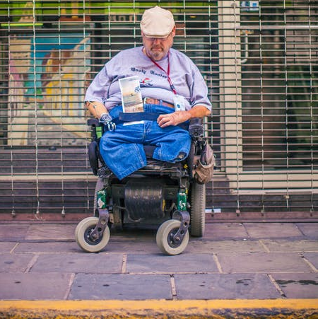
Mobility Disabilities

Slide 8
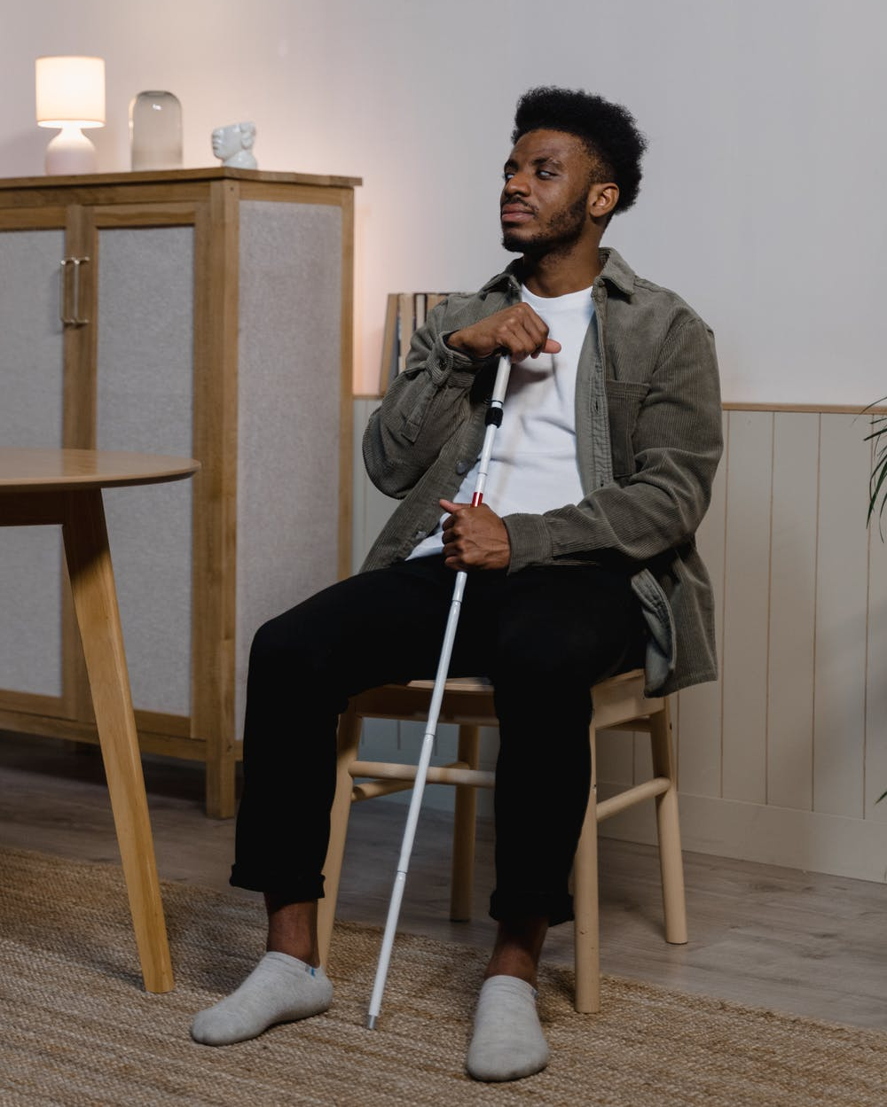

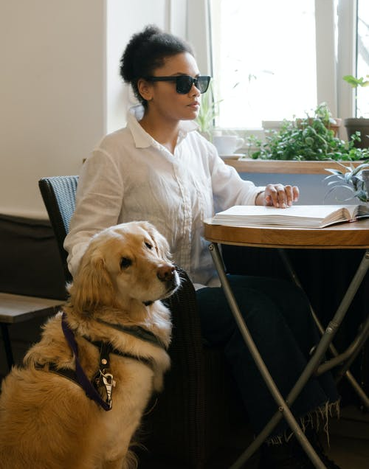
Blindness

Slide 9

Perceptions and Attitudes – What are they and where do they come from?

Slide 10
Perceptions and Attitudes – What are they?
Perception – use of the mind or senses to comprehend or understand our surroundings
Attitude – an actual feeling or way of thinking about something or someone based on a perception
  Positive
  Negative
There is a link between our perceptions/attitudes
and our everyday behavior

Slide 11
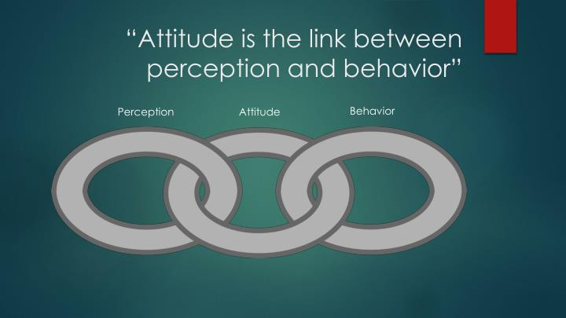
Perceptions and Attitudes – Where do they come from?
Our culture
Ethnicity
Family
Friends
Community
Knowledge (education)
Religion
Experience
Media/Social Media
Politics
Workplace
Other places?
Q&A

Slide 12
Prejudice, Stigma, Discrimination
It can be common to judge or be wary of behaviors that we do not understand
Words matter. They can support or humiliate/devalue people

Slide 13
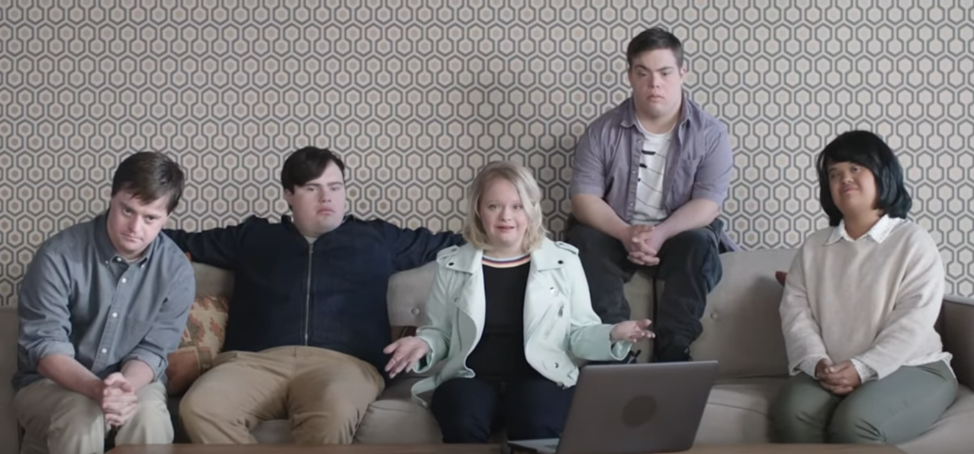

Video – “Not Special Needs”
Notes:
https://www.youtube.com/watch?v=rsjnHCZOfg8&ab_channel=DulceLopez

Slide 14

The Importance of Awareness
Who is living with a mental health condition, substance use disorder, and/or IDD?
Q&A

Slide 15
Changing Perceptions and Attitudes
Acknowledging our biases about others
Being willing to understand people different from you
Learning about our differences, but more so learning about what makes us similar and human
Applying knowledge and understanding when providing a response to a crisis

Slide 16

Understanding Disability
Disability is not a static concept
No two people with the same disability are the same
The Americans with Disabilities Act describes disability to be any condition that substantially limits one or more major life activities
Q&A

Slide 17
Categories of Disabilities
Sensory
Developmental
Physical
Learning
Age-Related
Mental Health

Slide 18
Respectful Language
Describe the person, not the disability or illness: “Person living with…”
Avoid offensive language
  “Cripple,” “suffering from,” “crazy,” “handicapped,” the “R” word
Learn from advocates about respectful language
When in doubt, ask the person
give
respect
get
respect

Slide 19
Principles of Recovery
Hope
Choice
Respect
Abolish Stigma
Person-First Language
Celebrate Diversity
Recovery is Possible
Q&A

Slide 20
Disability Culture and Community
The disability community is a community; it has its own culture, language, and customs.
Disability is often considered an identity by those with disabilities—something to be celebrated about who they are.
accepted
voice
community
interaction
SOCIAL-INCLUSION
acknowledged
normal
confidence
empowered
Q&A

Slide 21


Module Wrap-Up
Questions?
This curriculum was created through support by Grant No. 2020-NT-BX-K001 awarded by the Bureau of Justice Assistance. The Bureau of Justice Assistance is a component of the Department of Justice’s Office of Justice Programs, which also includes the Bureau of Justice Statistics, the National Institute of Justice, the Office of Juvenile Justice and Delinquency Prevention, the Office for Victims of Crime, and the SMART Office. Points of view or opinions in this document are those of the authors and do not necessarily reflect the official positions or policies of the U.S. Department of Justice.

