Slide 1



Scenario-Based Skills Training – De-escalation Communication Skills

Slide 2

Module Overview
De-escalation Communication Skills
Importance of Managing Crises
Guidelines for Defusing Crises
Effective Communication Skills
Dos and Don’ts of Verbal Interaction

Slide 3
What is Required in Effective Responses to Behavioral Health or IDD Crises?
Person-centered approaches
Non-judgmental approaches
Here-and-now approaches
Objective: To reduce anxiety and encourage meaningful communication

Slide 4
Why is Managing the Crisis Important?
Safety for all
Fewer tragedies
Better decisions
Better outcomes
Reduction of criminal justice involvement

Slide 5

Encouraging a Different Mindset
Control vs. Influence:
Using a less authoritarian, less commanding and less confrontational approach, can give you more control.
Try to give the person a sense that they have some control, because they are in a crisis. They are feeling out of control and normal coping mechanisms are not currently working.
change

Slide 6
Key Concepts for Effective Verbal De-escalation
Safety needs always come first
Decrease the intensity of a situation to return to a pre-crisis state
Use active listening to gain rapport and build trust
Set clear limits; communicate directly; create options
Promote appropriate resolutions based on an assessment of the facts

Slide 7
De-escalation: How Do You Do It? (part 1)
Maintain a safe distance
Be active in helping
Use a clear tone and voice
Build hope
Use a voice volume lower than that of the individual
Focus on strengths
Use a non-threatening posture (but maintain tactical awareness)
Present as a calming influence
Set limits
Demonstrate confidence and compassion

Slide 8
De-escalation: How Do You Do It? (part 2)
Remove distractions, disruptive or upsetting influences
Be aware that your uniform and tools on your belt may be intimidating
Provide careful, clear expectations, and instructions
Be consistent
Be aware of body language, be congruent
Use “I” statements
Validate and accept
Do not make promises you cannot keep

Slide 9
De-escalation: How Do You Do It (part 3)
Determine the person’s need for basic needs, including food and water
Be patient
LISTEN
Be non-judgmental
Use active listening skills

Slide 10

Officer’s Role in Influencing Behavioral Change: ACTIVE LISTENING
Situational Assessment
Active Listening
Empathy
Rapport
Influence
Behavior Change
Behavioral Change Stairway

Slide 11
Active Listening
A skill that can be developed
Takes time and practice
Requires a focus on verbal and nonverbal messages
Is non-judgmental

Slide 12
Active Listening (continued)
The biggest communication problem:
We do not listen to understand.
We listen to reply.
Q&A

Slide 13
Effective Communication Rule
Three important elements in any face-to-face encounter:
  Words Used (7%)
  Tone of Voice (38%)
  Body language (55%)
There must be consistency across all three elements for effective communication

Slide 14

Quick Class Roleplay
Sometimes it’s not what you say, but how you say it.
Say the following sentence with different tones:
In a suspicious tone
In a happy tone
In a patronizing tone
In an irritable tone
“You made it here on time.”
Q&A

Slide 15
Active Listening Skills
Attentiveness
Restatement
Reflection
Open-ended questions
Minimal encouragers
Effective pauses
Silence
SPEAK LESS LISTEN MORE

Slide 16

What Active Listening is NOT
Advice, judgement, or persuasion
Discussion of topics not expressed by the person in crisis
  The person’s feelings, values, statements, and opinions are what count.
Judgment-Free
Zone

Slide 17
Attentiveness
Focusing your attention completely on the person in crisis
  Words used
  Rate of speech
  Tone of voice
  Facial expressions
  Body language
Also, pay attention to the above in yourself
Q&A

Slide 18
Restatement
Restating or “feeding back” and clarifying the FACTS of the person’s crisis
Person in crisis: “I stopped taking my medicine after I was fired and I’m sleeping in my car.”
Officer: “So you were fired from your job” OR “You were fired and you’re sleeping in your car”

Slide 19
Restatement (continued)
THE FACTS
Person in Crisis: “I started back using and me and my wife went to fighting. She left me. I didn’t go in today. It was my last chance. I’m fired. It’s just not worth it anymore.”
Officer: “You were fired, and your wife left you.”

Slide 20
Reflection
Reflecting or “feeding back” the person’s FEELINGS about the crisis:
Person in Crisis: “I don’t understand what’s going on. I was just walking around the park. Someone started yelling at me. I didn’t know what was happening. I wanted to run.”
Officer: “I can see you are scared.”

Slide 21
Reflection (continued)
The Feelings:
Person in Crisis: “I’m a failure. I had two years. I was going to meetings. My wife and I were doing okay. Work was good. I can’t do anything right.”
Officer: “I can see you are upset about what has happened.”

Slide 22
Summarizing/Paraphrasing
Sorting through the information presented to pull out and paraphrase the essential ideas.
Requires you to determine what is important, condense the information, and state it in your own words.

Slide 23
Summarizing/Paraphrasing (continued)
“My husband keeps playing games with me. He is so manipulative. He is telling everyone it is my fault, that I am a bad mother saying I am unstable. I can’t help it if I get depressed at times. Life can be so tough and overwhelming. Now he is trying to keep me from seeing my own kids. I have the court papers that give me custody and he won’t send them back. What do I do?”

Slide 24
ACTIVITY
Scenario Practice: Restatement, Reflection, Summary

Slide 25
Officer’s Role in Influencing Behavioral Change: EMPATHY
Situational Assessment
Active Listening
Empathy
Rapport
Influence
Behavior Change
Behavioral Change Stairway

Slide 26
Empathy – What is it?
Empathy is the ability to recognize, understand, and share the thoughts and feelings of another person
Empathy is the ability to understand things from another person’s perspective

Slide 27

Demonstrating Empathy
Take a walk in my shoes
Accurately restating another person’s experience and reflecting on their feelings.
before you judge me

Slide 28


Empathy Video
Notes:
https://www.youtube.com/watch?v=1Evwgu369Jw&ab_channel=RSA

Slide 29

Empathy: Why is it Important?
Conveys understanding
Can make others feel understood and supported
Encourages others to share more
Creates a connection
Establishes rapport

Slide 30

Communicating Understanding
Simple, short phrases
“Interested” tone
Slow
At times, tentative…
Use empathic stems
UNDERSTANDING

Slide 31
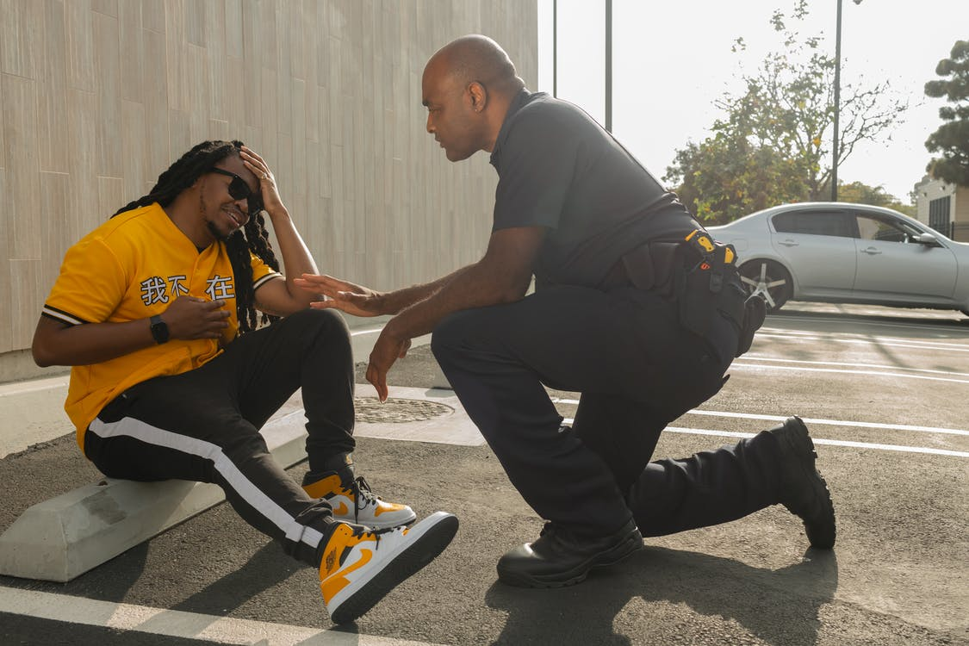
Empathic Stems
Maybe you feel….
Sounds like a _____ day
What a day you’ve had…
That is a lot to deal with.
You wish things were different.
It’s hard for you to know what to do…
Right now, it feels like there is no hope.
That is the last thing you wanted.
That’s confusing when that happens.
Q&A

Slide 32
Officer’s Role in Influencing Behavioral Change: RAPPORT
Situational Assessment
Active Listening
Empathy
Rapport
Influence
Behavior Change
Behavioral Change Stairway

Slide 33

Rapport
Building a relationship of mutual trust

Slide 34
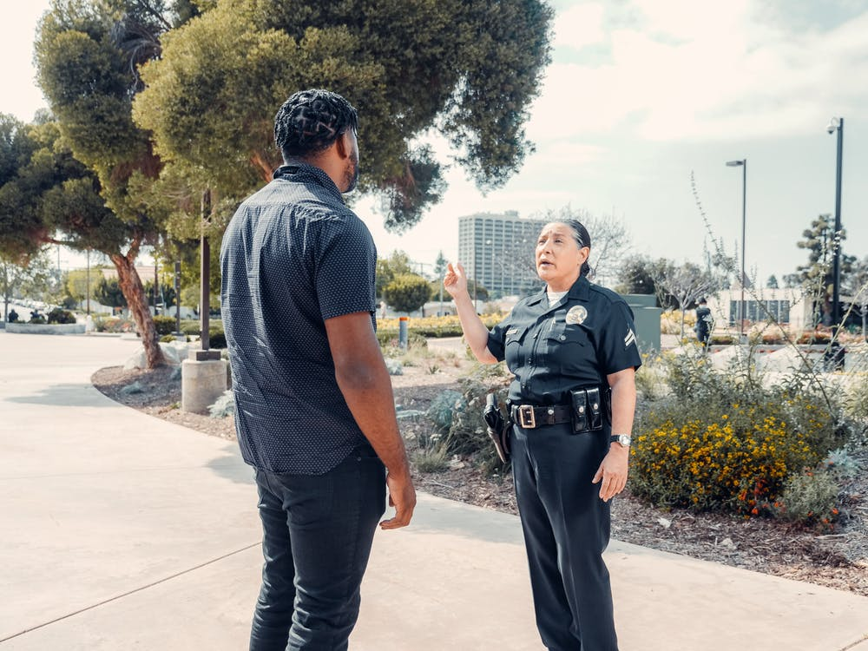
Rapport
CONNECT then DIRECT

Slide 35
Phrases That May Damage Rapport
“Calm Down”
“Relax”
“I Understand”
“You Should”
“You Shouldn’t”
“Why?”
Q&A

Slide 36
Officer’s Role in Influencing Behavioral Change: INFLUENCE AND BEHAVIOR CHANGE
Situational Assessment
Active Listening
Empathy
Rapport
Influence
Behavior Change
Behavioral Change Stairway

Slide 37

Facilitating an Outcome
Once a person is calmer and the emotions around the crisis have been de-escalated, the next step is facilitating the outcome:
Determine if there is a disability
Learn what the person may want
Explore resources to connect the person to ̶ this can include family, friends, community resources
Involuntary commitment should be the outcome of last resort

Slide 38
The Dos and Don’ts of Verbal De-escalation
DO
Show empathy
Reassure
Use active listening skills
Be patient
Build rapport
Guide the situation toward resolution
DON’T
Threaten
Argue
Challenge
Order
Shame
Blame

Slide 39


Module Wrap-Up
Questions?
This curriculum was created through support by Grant No. 2020-NT-BX-K001 awarded by the Bureau of Justice Assistance. The Bureau of Justice Assistance is a component of the Department of Justice’s Office of Justice Programs, which also includes the Bureau of Justice Statistics, the National Institute of Justice, the Office of Juvenile Justice and Delinquency Prevention, the Office for Victims of Crime, and the SMART Office. Points of view or opinions in this document are those of the authors and do not necessarily reflect the official positions or policies of the U.S. Department of Justice.

