Slide 1



Community Resources

Slide 2

Module Overview
Community Resources in [SITE NAME]
  Presenter Name, Title
  Contact Information
Hospital and/or Crisis Units
Mental Health Services
Substance Use Services
IDD Services
Older Adult Services
Peer-related Services

Slide 3
Hospitals and/or Crisis Units
[Hospital Name]
  Presenter Name, Title
  Contact Information
Hospital Services and Processes
  Appropriate situations for hospital services (IDD vs. MH?)

Slide 4
Evaluation Process
Process of police bringing individuals into the hospital
  Any “interface issues” at the front end?
Medical Clearance
  Why and what does this involve?
  Alcohol level
Referral to psychiatry when sober

Slide 5
Evaluation in the Emergency Department or Crisis Center/Unit
Psychiatric Evaluation: sources of information
  Documentation
  Verbal and written reports from law enforcement
  Patient Interview
  Previous Records
  Collateral Sources
  (Family/friends, treatment team, others in community)

Slide 6

Evaluations Involving Youth
Is there anything specific to youth that should be mentioned?
  Importance of having parents accompany child

Slide 7
Interventions When Not Admitted
Problem-Solving
Safety Planning
Possibly Medication
Referrals
  Mental Health Treatment
  Chemical Dependency Programs
  Shelters
  Other

Slide 8
Staffing
Staff
Number of Staff
Psychiatrist
Other staff?
Does it vary by day vs. evening and nights?

Slide 9
Inpatient Unit(s)
What happens on the unit?
Why is it helpful to people?
Average/typical length of stay

Slide 10

Other Community Services

Slide 11
Mobile Crisis Team
Who will they see?
  Specific crises? (MH vs. IDD, etc.)
Referral process
  Information needed
Hours of coverage
How quickly can they respond?

Slide 12
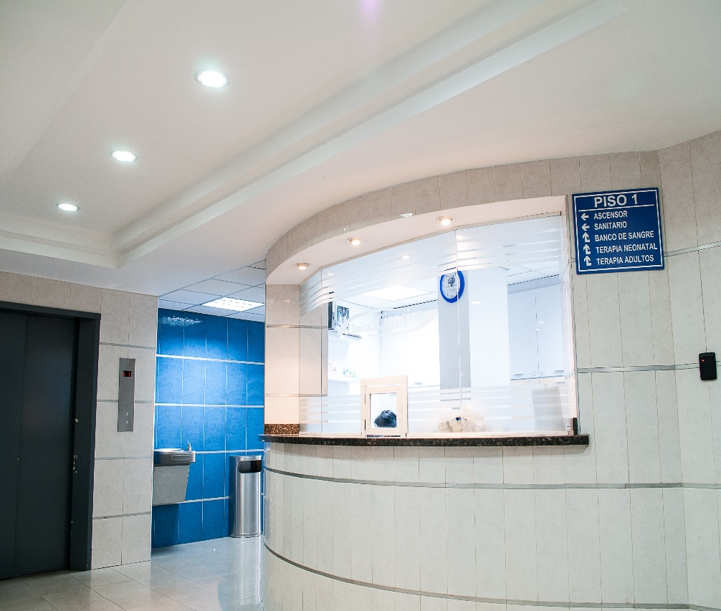
Other Crisis Services
Crisis and/or Peer Respite?
Crisis Drop-off/Crisis Stabilization Center
Crisis Hotline(s)
Warm Lines

Slide 13
Partial Hospitalization (if applicable)
Eligibility Criteria
Typical referral process
  From Emergency Department, inpatient and/or outpatient services
What is the treatment approach?
Average/typical length of stay

Slide 14

Local/Regional Detox and/or Rehab Units
Eligibility criteria
Length of stay
Typical referral sources upon leaving detox/rehab

Slide 15
Assertive Community Treatment (ACT)
ACT Program
Any Other Outreach Programs

Slide 16
Assisted-Outpatient Treatment (AOT)
List if an AOT program is available in your community

Slide 17
Mental Health Clinics
List
Brief description of services criteria and hours of operation

Slide 18
Substance Use and Chemical Dependency Clinics
List
Brief description of services criteria and hours of operation
List
Brief description of services criteria and hours of operation

Slide 19
IDD Services
Description of services provided
Local Care/Case Management Agencies

Slide 20
Older Adult Services
Description of services provided
Local Care/Case Management Agencies

Slide 21
Care/Case Management
Description of services provided
Local Care/Case Management Agencies

Slide 22
Residential Services
Mental Health
Substance Use

Slide 23
Residential Services (continued)
Youth-Specific
Developmental Disability

Slide 24


Other Support and Educational Services
National Alliance on Mental Illness (NAMI)
Mental Health Association
American Association on Intellectual and Developmental Disabilities
The Arc
The Treatment Advocacy Center
Other local services

Slide 25

Module Wrap-Up
Questions?
This curriculum was created through support by Grant No. 2020-NT-BX-K001 awarded by the Bureau of Justice Assistance. The Bureau of Justice Assistance is a component of the Department of Justice’s Office of Justice Programs, which also includes the Bureau of Justice Statistics, the National Institute of Justice, the Office of Juvenile Justice and Delinquency Prevention, the Office for Victims of Crime, and the SMART Office. Points of view or opinions in this document are those of the authors and do not necessarily reflect the official positions or policies of the U.S. Department of Justice.

