Slide 1



Veterans

Slide 2

Module Overview
Veteran populations
Issues impacting veterans
Resources for veterans

Slide 3
Local Statistics on Veterans and
Service Members
Insert local statistics on how many veterans and service members reside in your community
Compare your #s to national averages or other communities like yours
Discuss common calls for service/frequent encounters with veterans in your community
Include number of reservists residing in your state or your community
Include other relevant statistics, such as:
  # of veterans involved with veteran’s court, if you have one
  # of veterans in the jail
  # of veterans who are experiencing homelessness

Slide 4
Issues Impacting Combat Veterans
Alcohol and substance use
PTSD
Traumatic brain injury
Difficulty adjusting to civilian life
Isolation
Economic disadvantages (e.g., under-employment, homelessness)
Family/relationship strife
Criminal Justice involvement

Slide 5
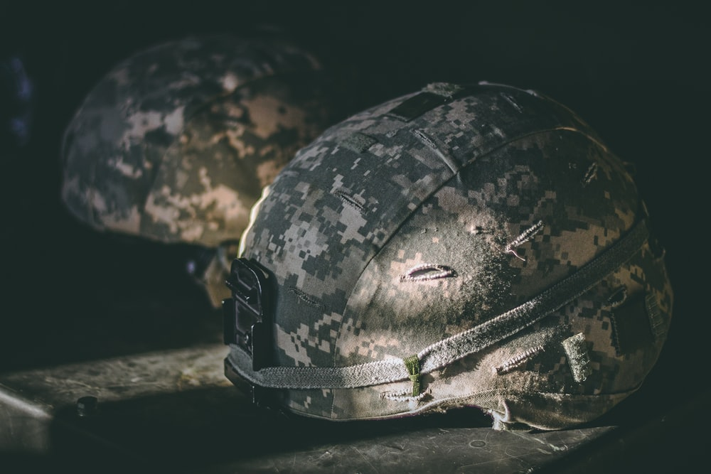
Veterans and Justice Involvement
Veterans are no more likely to be arrested than other adults
Approximately 7% of the jail/prison population are veterans
Over half of veterans in the criminal justice system have mental health conditions or substance use disorders

Slide 6
Local Resources for Veterans
For all veterans:
  VA Healthcare system
  Vet Centers
  List other local, non-profit organizations that provide veterans’ behavioral health, housing, and financial support services
For veterans involved in the justice system:
  Veteran Justice Outreach (VA service)
  Veteran Treatment Courts
  Veterans Pods (in correctional facilities)
  The Health Care for Reentry Veterans (HCRV) Program (VA service)
  https://www.va.gov/homeless/reentry.asp

Slide 7


Optional Video:
Veterans Come Home to Civilian Life
Q&A
Notes:
https://www.youtube.com/watch?v=c5gsd4FbwH8&ab_channel=AJ%2B (3:46)

Slide 8
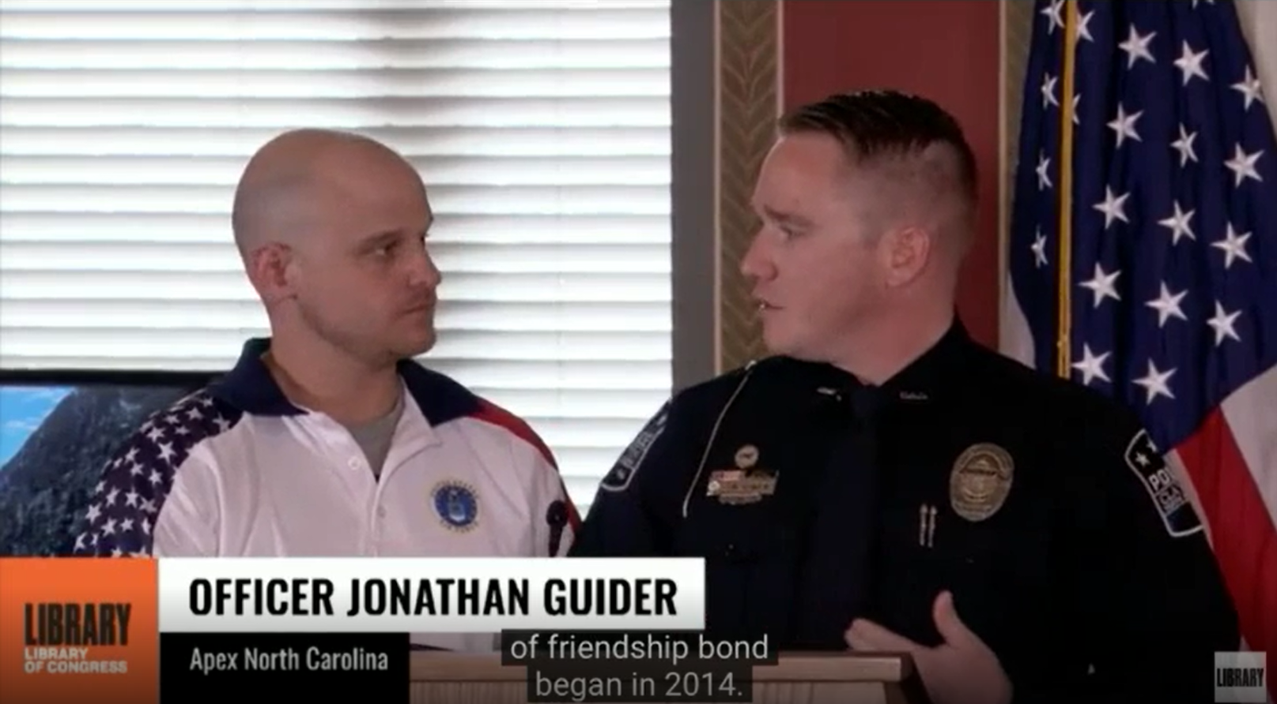
Optional Video:
Law Enforcement Response to Veterans
Q&A
Notes:
https://s3.amazonaws.com/static.nicic.gov/Public/guider-blalock-720.mp4 (11:25) (approved for public use by Library of Congress)

Slide 9
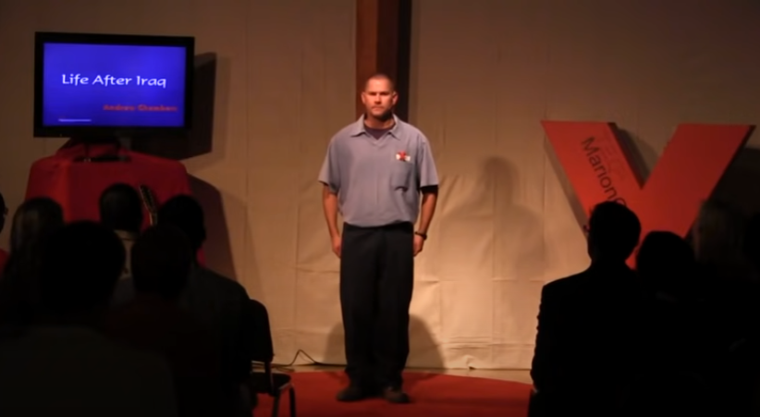
Optional Video:
Andrew Chambers’ TED Talk
Q&A
Notes:
https://www.youtube.com/watch?v=X6AYmzunPlQ&ab_channel=TEDxTalks (9:01)

Slide 10
Tips for Responding
Ask if the person ever served in the military. If yes, thank them.
Check for weapons
Help the person feel safe
Slow things down
Gather information
Know local resources and their different payment options
It’s okay to acknowledge you did not serve in the military if they ask; Offer for them to speak to an officer who is a veteran to feel more comfortable
QUICK TIPS

Slide 11


Module Wrap-Up
Questions?
This curriculum was created through support by Grant No. 2020-NT-BX-K001 awarded by the Bureau of Justice Assistance. The Bureau of Justice Assistance is a component of the Department of Justice’s Office of Justice Programs, which also includes the Bureau of Justice Statistics, the National Institute of Justice, the Office of Juvenile Justice and Delinquency Prevention, the Office for Victims of Crime, and the SMART Office. Points of view or opinions in this document are those of the authors and do not necessarily reflect the official positions or policies of the U.S. Department of Justice.

