Slide 1



Legal and Policy Topics

Slide 2

Module Overview
Federal Laws
State Laws
Agency Policies and Procedures
Key Takeaways

Slide 3
Federal Laws
U.S. Constitution
Defining Disability
Disability Rights Laws

Slide 4
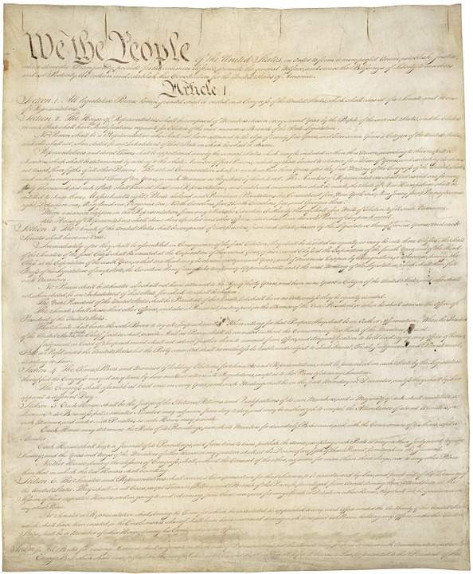
Relevant U.S. Constitutional Issues
Equal Protection
Acting under “Color of law”
Reasonableness

Slide 5
Defining Disability
Under the Americans with Disabilities Act (ADA), a person has a disability when they have:
  A physical or mental impairment that substantially limits one or more major life activities
  A record of such impairment, or
  Is regarded as having such an impairment

Slide 6
Disability Rights Laws
Title II of Americans with Disabilities Act (ADA): Requires officers to make reasonable accommodations for people with disabilities
Olmstead v. L.C. – Case Law
Section 504 of the Rehabilitation Act
Apply to everything officers do:
  Stops
  Searches
  Arrests
  Transports

Slide 7
Potential Types of Disability Discrimination
Overt/intentional discrimination/deliberate indifference
Wrongful arrest for disability-related behavior
Failure to ensure effective communication
Failure to reasonably modify practices, policies, and procedures

Slide 8
What Type of Discrimination?
Officer arrests someone on suspicion of intoxication, but the person is not intoxicated. They have a disability that affects their movement and speech.
Officer speaks to a person’s family member instead of the person with a disability directly, because the person uses their iPad to communicate.

Slide 9
State Laws
State Disability Rights Laws
State Commitment Law

Slide 10
State Disability Rights Laws
[insert your state’s disability rights laws that are relevant for law enforcement]

Slide 11
Civil Involuntary Commitment Law

Slide 12
Commitment as a Last Resort
The civil commitment law is a LAST RESORT for resolution of a mental health crisis.
Using least restrictive alternatives, when possible, is less invasive, protects the individual’s rights and increases the possibility of successful outcomes.

Slide 13
Alternatives to Using the Civil Involuntary Commitment Law
Other crisis response resources – mobile crisis teams, crisis lines
Community resources – case management, outpatient services, peer support
Consult with family and friends for resources
Voluntary admission
Other state statutes for substance use, IDD, dementia

Slide 14
Civil Involuntary Commitment Law
[placeholder for local presenter’s slides regarding state and local laws for civil involuntary commitment]

Slide 15
Individual Rights
[placeholder for local presenter’s slides regarding clients’ rights for involuntary and voluntary hospital admission]

Slide 16
Confidentiality and Privacy
Variety of federal and state statutes and case law governing confidentiality
  Unless person, guardian, guardian advocate, or surrogate/proxy waives by express and informed consent, confidentiality shall be upheld
Officers are generally not bound by confidentiality laws
  Can share information to providers and to family members
Family members can provide information to the mental health provider, even if the mental health provider cannot release information or discuss the person’s treatment without express and informed consent

Slide 17
Who Initiates?
Who can initiate an involuntary commitment process according to state law?

Slide 18
Assessment Considerations for Mental Health Condition Indicators
Verbal indicators
  What the person is saying and how they are saying it
Behavioral indicators
  Observation of abnormal behavior
  Body language
Environmental indicators
  Observation about the person’s environment that may indicate a mental health condition or another condition
No one indicator by itself meets the legal element of the law (totality of circumstances)
Q&A

Slide 19
Report Writing
[placeholder for local presenter’s slides regarding report writing – fill in with the form or categories in a report that the officer will complete]

Slide 20
Transportation and Other Law Enforcement Requirements/Considerations
[placeholder for local presenter’s slides according to statute, policy and/or contract agreements between agencies]

Slide 21
Civil Involuntary Commitment Process
[placeholder for local presenter’s slides of a brief outline of the process from the time an officer drops the person off for an evaluation to discharge, including due process considerations and individual rights]

Slide 22
Agency Policies and Procedures
Policies and procedures pertaining to people with disabilities

Slide 23
Agency Policies and Procedures (continued)
[placeholder for site-specific information related to relevant agency policies and procedures as it pertains to people with disabilities]

Slide 24
Key Takeaways
There are a variety of laws that affect interactions with individuals experiencing a crisis
Officers have responsibilities to ensure a person’s rights are protected and to avoid discrimination based on disability
Civil commitment is a last resort option and should only be used if there are no less restrictive alternatives appropriate to the person’s needs
Officers should explore less restrictive interventions appropriate to the person’s needs, including de-escalation and/or engagement with community resources to resolve on scene
When in doubt, seek guidance from a supervisor

Slide 25


Module Wrap-Up
Questions?
This curriculum was created through support by Grant No. 2020-NT-BX-K001 awarded by the Bureau of Justice Assistance. The Bureau of Justice Assistance is a component of the Department of Justice’s Office of Justice Programs, which also includes the Bureau of Justice Statistics, the National Institute of Justice, the Office of Juvenile Justice and Delinquency Prevention, the Office for Victims of Crime, and the SMART Office. Points of view or opinions in this document are those of the authors and do not necessarily reflect the official positions or policies of the U.S. Department of Justice.

